Slide 1
Day 5: Language and Style

Slide 2
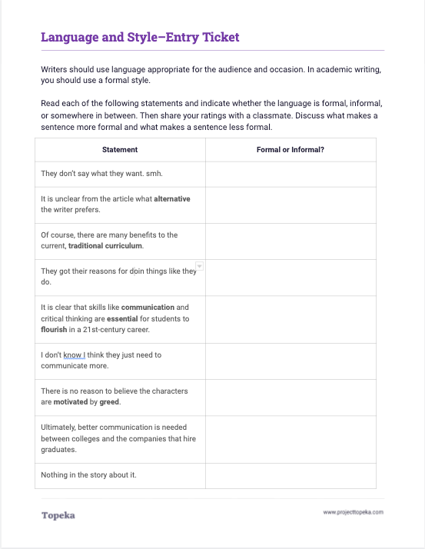
Entry Ticket
Complete the Entry Ticket activity to determine whether each statement uses formal or informal style. Afterward, discuss your answers with a neighbor.
2
Notes:
Upon completion of activity, Teacher should invite students to Pair and Share with a classmate to discuss their answers.
When you’re finished identifying formal or informal sentences, turn to a neighbor and talk about what attributes of language make something formal or informal. See if you can come up with rules for formal and informal style.

Slide 3
In this lesson, you will learn…
what audience is
how to consider your audience
what is formal and informal style
Notes:
Teacher presents learning objectives for session:
In earlier lessons we discussed the different components of an argument and how an argument should be organized.
Today, we’re going to talk about audience and style: what an audience is, how to consider your audience when writing, and the difference between formal and informal style in academic writing.

Slide 4
What is an audience?
Your audience is the group of people to whom you are presenting your argument.
Notes:
Teacher introduces the concept of an audience for an argument. Sample script:
When you’re making an argument you’re trying to convince someone to accept your claim. That “someone” is your audience, the people to whom you’re presenting your argument.
Teacher asks students to name the audience for a few different arguments. For example,
You are arguing for a longer lunch period—who would your audience be?
You’re arguing to determine what movie to see this weekend—who would your audience be?
You’re arguing for a raise at a job—who would the audience be?

Slide 5
The language and style of your argument should be chosen to appeal to your audience.
Choosing appropriate words and style will make your argument stronger.
Why does audience matter?
Notes:
Teacher discusses why audience and style matter in argumentative writing.
Why do we need to understand who the audience is?
The language and style of your argument should be chosen to appeal to your audience.
Choosing appropriate language and using the right style will make your argument stronger.

Slide 6
Consider your audience.
What they know:
Their point of view:
Nothing about the topic
Many things about the topic
Some may agree
Some may disagree
Notes:
Teacher explains the different characteristics of an audience that go into determining style.
There are multiple ways to consider your audience when you’re making an argument:
First, how much does your audience know about the topic? Do they know a little or a lot?
Does the audience already agree with you, and you’re trying to get them to take action? Or do they already disagree, and you’re hoping to change minds?

Slide 7
Consider your audience.
Their standards:
The occasion:
Some expect casual
Some expect formal
Students in the lunchroom vs.
Students reading the school newspaper
Notes:
Does the audience have particular standards for communication? Are they casual or are they formal?
And finally, what is the occasion? What circumstances led you to develop the argument in the first place?
Say you’re making an argument about what is served for school lunch. Are you addressing the student council? Trying to convince other students in the cafeteria? Or are you writing an article for the school newspaper? Though the people are similar, the occasion is different, and each occasion demands a different style.

Slide 8
Strong arguments include language that will appeal to your audience from all of these different angles.
Think
about your audience.
Notes:
Strong arguments include language that will appeal to your audience from all of these different angles. Once you’ve considered your audience, you can make choices about whether to use formal or informal style.

Slide 9
Style is seen in the choices a writers makes about vocabulary, sentence structure, and organization.
Formal
Informal
What are formal and informal styles?
Formal style is the use of impersonal, objective, and precise language.
“In his op-ed, the author outlines a number of outdated practices that remain ingrained in school systems.”
Informal style uses conversational, subjective, or slang language.
“This guy is giving his opinion about a bunch of things schools still do because they just can’t get with the times.”
Notes:
Teacher begins discussion of differences between formal and informal style.
Style is seen in the choices a writer makes about vocabulary, sentence structure, and organization. Your writing for school should always use formal style.
Teacher should refer to general examples on the slide for formal vs. informal style.

Slide 10
Formal word choices are
grammatically correct;
polite;
technical and precise;
full words, not contractions or abbreviations; and
not slang.
How does formal style affect word choice?
Notes:
Teacher discusses how formal style is seen in word choices.
Formal word choices are
grammatically correct—they follow standard conventions;
polite—they do not use derogatory terms or insult the reader;
technical and precise—precise words make your meaning clear (for example, in a domain such as science, words should be precise like “beaker,” versus imprecise like “thing for holding chemicals”);
full words, not contractions or abbreviations—avoid don’t, isn’t, doesn’t, and the like; avoid emojis and texting language; and
not slang.
With an informal style of writing, a writer or speaker would have fewer rules to follow. The writer's choice of words could be more casual and conversational, and can break the rules above. Sometimes in informal writing, writers make deliberate choices that do not follow grammatical rules.
In the entry ticket activity, did anyone identify statements as informal because of informal word choices?

Slide 11
Formal sentence structures use
complete sentences;
varied sentence beginnings; and
key transitional words and phrases that show relationships between sentences and paragraphs.
How does formal style affect sentence structure?
Notes:
How does formal style affect sentence structure?
Formal sentence structures use
complete sentences;
variety in the way sentences start; and
key transitional words and phrases that show relationships between sentences and paragraphs
With an informal style of writing, a writer or speaker would again have fewer rules to follow. The writer's sentence structure might be more fragmented, casual and conversational, and could include run-ons and other grammatically incorrect structures.
Is there anything in the entry ticket that you identified as informal because of informal sentence structure?

Slide 12
Formal organization uses
formal structure with introduction, body, and conclusion;
clear organizational structure; and
fully developed paragraphs.
How does formal style affect organization?
Notes:
How does formal style affect organization?
Formal organization is the type of organization we talked about in a previous lesson. A formal argument includes an introduction, body, and conclusion. It has a clear organizational structure and fully developed paragraphs
With an informal style of writing, the organizational patterns might use less formal structures, leaving some points less clearly developed or having less structure in the sequence or development of each point used to support the claim.

Slide 13
When the subject is serious and important
When the audience contains authority figures
When the writer is unfamiliar with the audience
When is formal style appropriate?
Notes:
Teacher explains how to determine when formal style is appropriate
When is formal style appropriate?
When the subject is serious and important
When the audience contains authority figures
When the writer is unfamiliar with the audience
What does that mean for your arguments for school?
Teacher pauses for student contributions. If necessary, teacher emphasizes that arguments in academic settings should always use formal style because of all three reasons given.

Slide 14
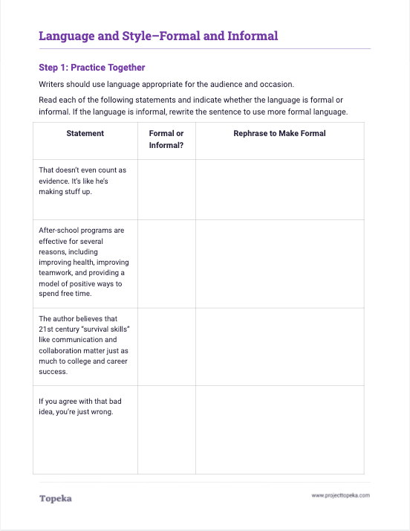
You do it together.
Complete Step 1 to identify and correct informal style in the sample statements.
2
Notes:
Distribute Activity - Formal and Informal. Teacher instructs students to work in pairs or small groups in order to complete Step 1 identifying informal language and rephrasing to make formal.

Slide 15
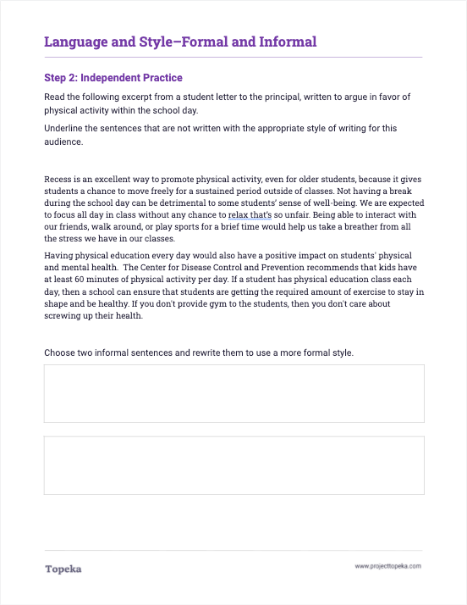
Independent Application
Complete Step 2 to identify and correct informal style in the sample paragraphs.
2
Notes:
Teacher has students turn to Step 2 of the activity.
Now you will have a chance to practice this on your own. Step two provides two paragraphs that contain both formal and informal language. Underline the sentences that are informal, and then, choose two of the informal sentences to revise using more formal language.

