Slide 1
Day 4: Organization

Slide 2
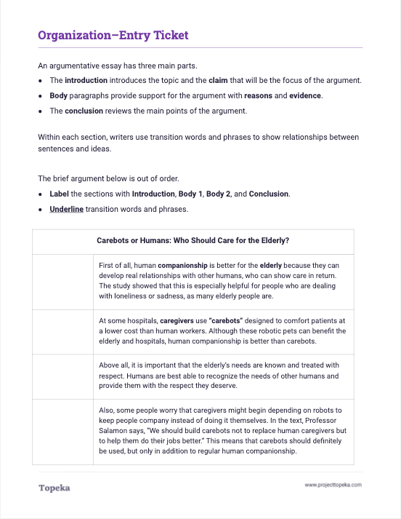
Entry Ticket
Read the sample text and label the parts of the argument. Underline the transition words.
2

Slide 3
In this lesson, you will learn…
the basic organization of an argumentative essay
strategies for organizing
the purpose of transition words and phrases
Notes:
Teacher presents learning objectives for session:
In earlier lessons we discussed the importance of having a good claim and strong support for the argument. Today we’re going to discuss how an argument should be organized, including
basic organization of an argumentative essay
strategies for organizing body paragraphs
the purpose of transition words and phrases for enhancing organization

Slide 4
Parts of an Argument
Arguments start with an introduction, which should contain a summary and a claim.
The claim creates the focus for the body of the argument, which contains reasons and evidence to support the claim.
The argument ends with a conclusion, which recaps the main points and calls readers to action or provides final insights on the topic.
Notes:
Teacher presents brief description of each part. See slide for text.

Slide 5
Sample Outline
Introduction
Summary & Claim
Body
1st Paragraph
Reason, Evidence & Reasoning
2nd Paragraph
Reason, Evidence & Reasoning
3rd Paragraph
Reason, Evidence & Reasoning
Conclusion
Notes:
Teacher walks through how these parts look when placed in an outline. Sample script:
This is an outline of a brief argumentative essay. At the very beginning you have the introduction, which must contain your claim, and should contain an brief description or summary of the “ongoing issue.”
After the introduction comes the body, which contains your support for your claim. Each paragraph in the body should provide a reason for your claim, evidence connected to the reason, and an explanation of how the evidence connects back to the claim. This explanation is your reasoning.
Finally you have a conclusion. Your conclusion should wrap up the argument. It should restate your claim and provide a brief summary of how you proved your position.
Teacher continues to explain organization in the context of the entry ticket.
Let’s return to the entry ticket. Who can tell me what the introduction to the argument is?
Pause to allow a student to answer: “At some hospitals, caregivers use ‘carebots’ designed to comfort patients. Although robotic pets can benefit the elderly, human companionship is better than carebots.”
How do you know this? Because this paragraph provides the claim.

Slide 6
Parts of an Argument: Introduction
The introduction tells what your argument is about. A strong claim should be included in the introduction. The rest of the argument will focus on the claim.
Notes:
The introduction tells what your argument is about. A strong claim should be included in the introduction. The rest of the argument will focus on the claim.

Slide 7
There are common steps to use when writing an introduction to an argument:
Summarize the topic or “ongoing argument”
Present your claim: do you agree, disagree, or take another position?
State your reasons why
Writing an Introduction
Notes:
This introduction in the worksheet is just a couple of sentences. In your essays you'll want to provide more than that, and there are steps you can take to build a great introduction.
First, a great way to show that you understand the topic you're writing about is to summarize the "ongoing argument" that you read about in the text. For example, in a complete essay on this topic, the introduction might contain a longer summary with more detail about the text that this is based on.
Then you present your claim. Do you agree, disagree, or take another position? For example: “Although robotic pets can benefit the elderly, human companionship is better than carebots."
If space allows, you can give a very brief overview of the reasons you’ll present in the body of the essay.

Slide 8
Parts of an Argument: Body Paragraphs
Body paragraphs support the claim by presenting reasons, evidence, and reasoning.
Notes:
Teacher presents explanation of body paragraph structure.
After the introduction comes the body of your argument. This is where you present the reasons and evidence for your claim and explain with reasoning how your reasons and evidence connect to the claim.

Slide 9
Introduction:
Summary and Claim
Parts of an Argument: Body Paragraphs
Reason
Evidence
Reasoning
Reason
Evidence
Reasoning
Reason
Evidence
Reasoning
Conclusion
Notes:
Teacher presents construction of body paragraphs
Your body paragraphs should be carefully constructed to make sure they are focused on supporting the claim.
Take a look at this graphic. In a typical argument, within each of the body paragraphs you'll find
a reason,
evidence from the text,
and reasoning that provides an explanation of how the reason and evidence connect to each other and to the claim.
Let's look at an example.

Slide 10
This shows that there is an element of dishonesty in the use of robotic pets for dementia patients.
The text explains, “When dementia patients find out that the robot companion is not a real pet, we find that sometimes they don’t engage with it as much.”
Another reason that carebots should not replace human caregivers is that patients sometimes have to be tricked into thinking the bots are real in order for them to work.
Order the sentences.
Notes:
Teacher leads students through whole class ordering of sentences into an effective reason paragraph.
Here are three sentences that we can put together to create another reason for the essay from the entry ticket. Let's create a body paragraph here.
Read these sentences and tell me which one provides the reason. That's what we would put first.
Teacher pauses to allow students to participate.
What should follow the sentence that states the reason?
Teacher pauses to allow students to participate.
Which leaves the third sentence to connect the reason and evidence back to the claim.
Have someone read the entire paragraph.

Slide 11
Parts of an Argument: Conclusion
The conclusion is the end of your argument and sums up all of the information you have presented about your claim.
In your conclusion
restate your claim;
summarize how you proved or defended your claim; and
encourage readers to agree or take action, or share final thoughts or insights.
Notes:
Teacher explains the purpose of the conclusion.
At the end of the essay is the conclusion. The conclusion sums up all of the information you have presented about your claim.
What conclusion did you identify in the entry ticket activity? How did you know?
Teacher pauses to allow students to participate.
In your conclusion you should restate your claim. A strong conclusion will summarize how you proved or defended your claim and encourage readers to agree or take action, or give them a final thought to take away.
What is the final thought in the sample from the activity?
Teacher pauses to allow students to participate.

Slide 12
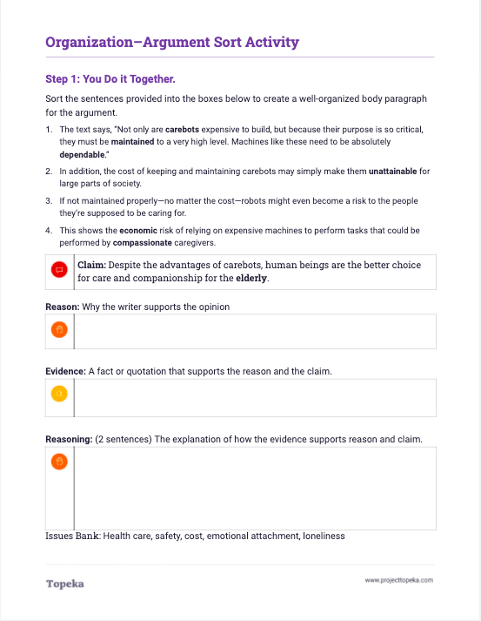
You do it together.
Work with others to order the sentences to create another reason paragraph for the body of the essay.
2
Notes:
Using Paragraph Sort Activity, Teacher divides class into pairs or small groups to begin Step 1 and repeat the process sorting sentences into a unified reason paragraph.
When finished, teacher leads class through debrief to discuss students’ answers and explanations.

Slide 13
Paragraphs should be organized logically.
There are different ways to organize paragraphs logically. For example,
list reasons, weakest to strongest,
present a sequence,
show cause and effect,
address a reason and counterargument in each paragraph, and
present the pros and cons of each aspect of the proposal.
Parts of an Argument: Body Paragraphs
Notes:
Teacher introduces logical organization of body paragraphs.
Now that you know how to organize your thoughts into a reason paragraph, you can think about how to organize your reasons.
Body paragraphs should be organized logically.
There are different ways to organize paragraphs logically. For example (refer to slide):
By reasons, weakest to strongest
By sequence or cause and effect
By addressing a reason and counterargument in each paragraph
By listing all the pros, then all the cons
When you make a decision about how to organize your reasons, you can make that decision clear by using good transitions.

Slide 14
Using Transition Words and Phrases
Transitions are word and phrases that help connect the ideas in your argument.
You can use transition words and phrases to make your ideas and organization clear to readers.
Notes:
Teacher presents transitions to make organization clear:
Transitions are words and phrases that help connect the ideas in your argument.
Transitions serve many purposes. One purpose is to make your organization clear to readers.

Slide 15
Transitions to Show Organization
To show order
To show importance
To contrast ideas
First of all…
Next…
Finally…
Above all…
Mainly…
More importantly…
Surely…
Some argue… However…
On one hand… On the other hand…
On the contrary…
Nevertheless…
Notes:
For example, if you want to show things in a sequential order, you can use First, Second, Third, or First, Next, Finally.
If you want to show things in order of importance, you might use First, More importantly, and Above all.
If you have arranged your reason paragraphs to respond to counterarguments, you might use Some argue and However, or something similar.

Slide 16
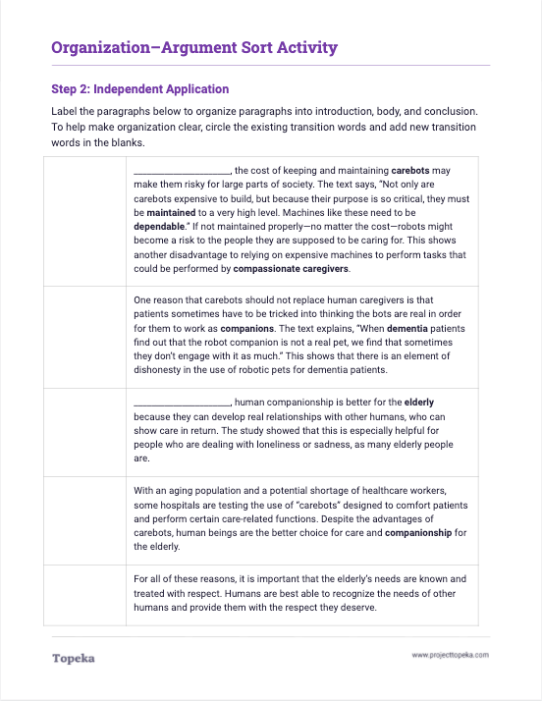
Independent Application
Work individually to complete step 2 of the handout to organize the paragraphs of the essay.
2
Notes:
Teacher has students turn to Step 2 of the Argument Sort activity.
Now you will practice organizing these paragraphs into an argumentative essay. Label the paragraphs and then add transition words to show the organization strategy you’re using.
Teacher will circulate to provide support as needed.
If time allows, teacher will lead students in a full-class debrief of the exercise.

