Slide 1
Day 3: Support and Evidence

Slide 2
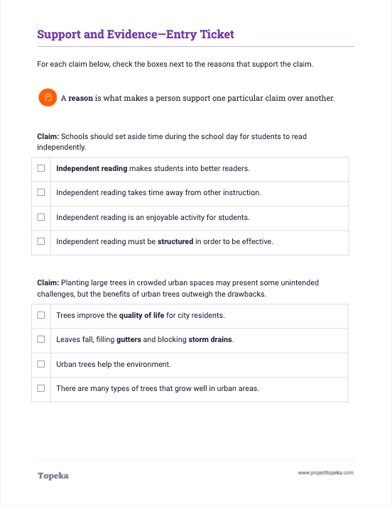
Entry Ticket
Identify the reasons connected to each claim.
2
Notes:
Set the purpose for the class with an Entry Ticket activity to activate prior knowledge of how reasons connect to claims.
Upon completion, teacher should invite students to turn and talk to a neighbor to discuss answers.
Discuss your answers with your neighbor. If you disagree, explain how you think the reason does or does not connect to the claim.

Slide 3
Reasons and reasoning help build arguments.
Reasons
Reasoning
Reasons explain why you believe your claim
Reasons provide an organizational structure
Links your evidence to your reasons and back to your claim
Explains how you interpret evidence
Demonstrates your knowledge of the topic or text
Notes:
Teacher explains the importance of strong reasons and effective reasoning:
In the entry ticket activity you identified reasons that would or would not support a claim. Reasons and reasoning are very important in writing arguments—these are the building blocks of the support you’ll give for your claim. Without the reasoning to organize and explain your use of evidence, the evidence and argument aren’t as strong.
Reasons explain why you believe your claim. For example, imagine I were making this claim: Schools should set aside time during the school day for students to read independently.
My reasons might be independent reading makes students into better readers and independent reading is an enjoyable activity for students.
Reasoning is an explanation of how your reason (and the evidence you’ll add) connect to your claim.

Slide 4
What is the difference between reasons and reasoning?
Reasons
Reasoning
What you think
The main points of your argument
Why you think this reason is proven by evidence.
Explains your thinking about evidence and its link to your reasons and claim
Notes:
Reasons are what you think
Reasoning is an explanation of how your evidence is relevant to your claim.

Slide 5
How do you support a claim with evidence?
Successful arguments use well-organized reasons and provide evidence to prove those reasons and support the claim.
Evidence comes from reliable sources.
Examples from real life can also be used as evidence.
Notes:
Teacher explains how evidence supports a claim:
When writing arguments, we use evidence to show that our reasons are valid—to prove that our argument should be accepted.

Slide 6

What makes good evidence?
Good evidence is…
Relevant
Appropriate
Valid
Related to the topic
Closely connected to the reason
Not outdated
From a trustworthy source
Closely connected to the focus of claim
Closely connected to the reason it supports
Accurate
True
From reliable and authoritative sources
Notes:
Teacher summarizes what makes evidence strong. See slide contents.

Slide 7





Claim
Students should be allowed to use cell phones at school.
Reason
Cell phones improve student safety.
Good evidence is relevant.
Relevant Evidence
For example, if a student is in a dangerous situation, they can call for help.
Not Relevant Evidence
According to the National Emergency Number Association, over 240 million calls are made to 911 in the U.S. each year.
Notes:
Teacher will introduce the claim “Students should be allowed to use cell phones at school.” Ask students to contribute to a discussion of good and bad evidence:
Good evidence is relevant. It’s related to the topic and closely connected to the reason. So here our reason is, “Cell phones improve student safety.” In this example, why does one piece of evidence work, and the other does not?

Slide 8
Claim
Students should be allowed to use cell phones at school.
Reason
Mobile apps can support learning.
Good evidence is appropriate.
Appropriate Evidence
Khan Academy, a popular learning application, has a mobile version.
Not Appropriate Evidence
All my classmates say that they frequently use their phones for homework.
Notes:
Good evidence is appropriate. It is from a trustworthy source and is closely connected to the claim and reason. In this example, why does one piece of evidence work, and the other does not?

Slide 9
Claim
Students should be allowed to use cell phones at school.
Reason
Good evidence is valid.
Cell phones can help students access information everywhere.
Valid Evidence
Students can access definitions, formulas, and all sorts of web sites.
Not Valid Evidence
Every book on earth is on the internet.
Notes:
Good evidence is valid. It is true and accurate, and from reliable and authoritative sources. In this example, why does one piece of evidence work, and the other does not?

Slide 10
What is Reasoning?
Reasoning is an explanation of how your evidence proves your claim.
It provides the connection between your claim and your reasons and evidence.
Evidence
Reasoning
Claim
Notes:
Teacher explains reasoning.
We touched on the difference between reasons and reasoning earlier. Reasoning is your explanation of how your reason and evidence are relevant to the claim.

Slide 11
Reason: Cell phones enhance safety.
Reason: Mobile apps can support student learning.
For example…
Evidence: For example, if a student is in a dangerous situation, he or she can call for help.
Reasoning: In schools where students aren’t allowed to have cell phones, they aren’t able to call for assistance.
Evidence: Students can access definitions, formulas, and all sorts of web sites and apps.
Reasoning: Students can use these tools to find and learn information quickly and avoid having to waste their time memorizing things they can easily look up.
Claim: Students should be allowed to use cell phones at school.
Notes:
For example, here is the same claim and reasons we used before.
Teacher models:
If my claim is “Students should be allowed to use cell phones at school,” and my reason is “Cell phones enhance safety,” I need to prove that reason is valid. So I’ll give an example: “In a dangerous situation, a cell phone allows a student to call for help.”
Now I need to connect my evidence back to my claim. For example, “In schools where cell phones aren’t allowed, students can’t call for assistance.”
Let’s look at the second example. Here my reason is “Mobile apps can support student learning,” Again, I need to prove that reason is valid. So I’ll give an example: “Students can access definitions, formulas, and all sorts of web sites and apps.”
Now I need to connect my evidence back to my claim. “Students can use these tools to find and learn information quickly and avoid having to waste their time memorizing things they can easily look up.”
Prompt class to repeat the process of supporting the existing claim by naming a reason, providing evidence, and then using reasoning to make the connection.
What other reasons can you think of to support cell phones in school? What evidence follows your reason? How do you explain the connection?

Slide 12
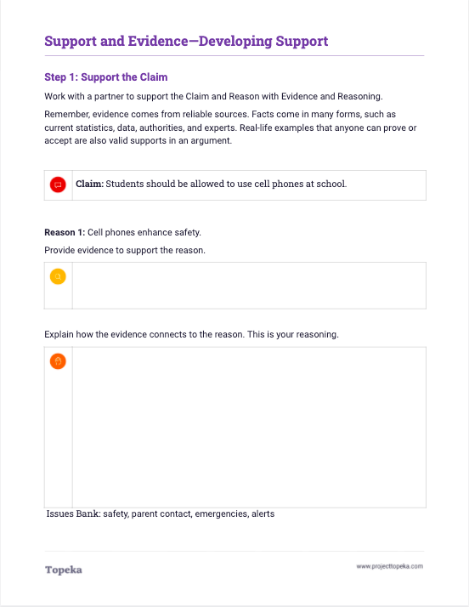
Developing Support Activity
Provide evidence and reasoning to support a given claim and evidence.
On your own, develop the counterargument.
2
Notes:
Using Developing Support activity, Step 1, prompt class to split into pairs or small groups to repeat the process of supporting the sample claim with a reason, evidence, and reasoning.
Using Developing Support activity, Step 2, teacher prompts class to work individually to develop a reason and supporting evidence for the opposing viewpoint.

Slide 13
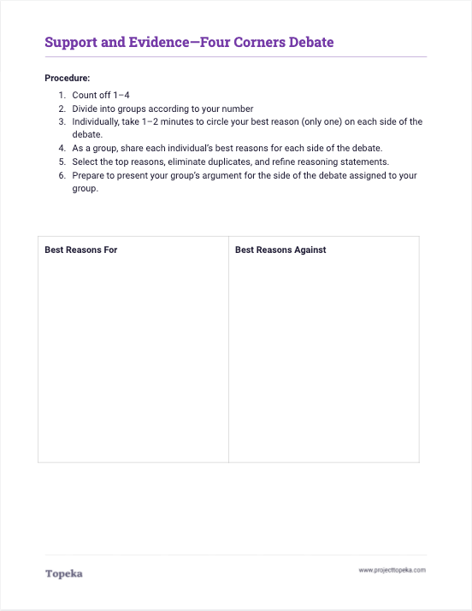
Four Corners Debate
In a group, make your best argument and then share with the class.
2
Notes:
See lesson plan for activity details.

