Slide 1
Day 2: Claim and Focus

Slide 2
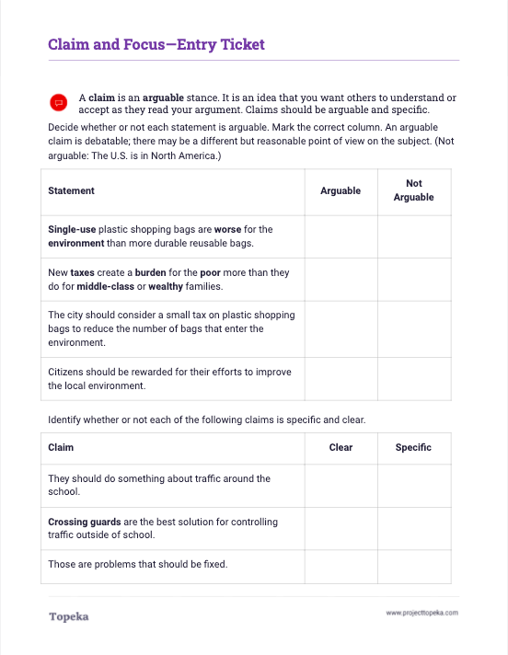
Entry Ticket
What do you already know about claims? Identify whether claims are arguable, clear, and specific.
2

Slide 3
In this lesson you will learn…
what a claim is
what makes a good claim
how a good claim addresses the needs of the writing prompt
Notes:
Teacher will set the purpose for the day by describing what will be covered.
The activity you just completed had you examine some example claims. In this lesson, we’re going to look closely at what it means to make a claim and what a strong claim looks like, and then we will discuss how a strong claim can help focus an argument. You’ll be able to practice writing a claim and making sure that claim addresses the needs of the writing prompt.

Slide 4
What is a claim?
Your claim is your position on an issue. When you make an argument, you’re trying to convince readers to accept your claim.
Notes:
Teacher will present concepts in the context of a review of the entry ticket.
In the Entry Ticket you analyzed some statements to decide whether or not the statements could be considered strong claims. Let’s review what a claim is.
Your claim is your position on an issue in an argument. When you make an argument, you’re trying to convince readers to accept your claim.

Slide 5



Summary and Claim
Reason
Evidence
Reasoning
The rest of your argument should be focused on supporting your claim.
Reason
Evidence
Reasoning
Reason
Evidence
Reasoning
Conclusion
Notes:
The rest of your argument should be focused on the claim.
Each of your reasons will provide support for the claim. Your evidence will help prove your reasons and your reasoning will explain how the evidence and reason are connected to the claim.
It's much easier to develop strong support when you have a good claim. So what makes a good claim?

Slide 6

What makes a strong claim?
A strong claim is…
Clear
Arguable
Specific
It states your point of view clearly.
The city should consider a small tax on plastic shopping bags to reduce the number of bags that enter the environment.
It is debatable. A reasonable person could disagree.
Crossing guards are the best solution for controlling traffic outside of school.
It provides a specific idea the author will prove.
The school should create an annual award to recognize outstanding student volunteers.
Notes:
Teacher provides attributes of a strong claim:
A strong claim is clear: For example, "The city should consider a small tax on single-use plastic shopping bags to reduce the number of bags that enter the environment." An unclear version of that might be "They should tax bags because of plastic."
Is there a claim in the entry ticket that’s clear?
Teacher pauses to allow student participation.
A strong claim is also arguable. A fact is not arguable. A statement like "There are 100 members in the United States Senate" is true or untrue, but there aren’t different reasonable views on the question.
Let's look at this example: "Crossing guards are the best solution for controlling traffic outside of school." I might think speed bumps are better. That's a reasonable alternative position, so the claim is arguable.
In the entry ticket, which of the claims are arguable?
Teacher pauses to allow student participation.
Finally, a strong claim is specific. A specific claim will provide enough detail that it will be obvious to readers what you are arguing for and you'll have an easier time focusing the argument around the claim. This claim is specific: “The school should create an annual award to recognize outstanding student volunteers.” A non-specific version of this might be “Someone should acknowledge volunteers.”
Which claims from the entry ticket could you consider to be specific?
Teacher pauses to allow student participation.

Slide 7


Let’s analyze a claim.
Claim: Schools should pay to sponsor basketball programs.
Is it clear?
Is it arguable?
Is it specific?
It is clear!
The writer is clearly in favor of basketball programs in schools.
It is arguable!
Reasonable people can hold a different position.
This position can be supported with reasons and evidence.
Not quite!
A more specific claim has additional detail: “Our middle school should sponsor an after-school recreational basketball program this winter.”
Notes:
Teacher models the process of analyzing an example claim with student input:
Let's consider the claim "Schools should pay to sponsor basketball programs."
First, I want to ask, “is it clear”? It's clear to me that the writer of this claim is in favor of basketball programs, so I'll say yes, this is clear.
Is it arguable? Well, reasonable people might prefer that their schools sponsor soccer programs or that school funds not be used for extracurricular activities at all.
Also, can I support this claim with reasons and evidence? Sure. So yes, it's arguable.
Is it specific? Not really. I don't know which school, which grade level, what type of program, or when it should be done. So this claim could be more specific.
For example, a more specific claim might be “Our middle school should sponsor an after-school recreational basketball league this winter.”
How else could we make this claim more specific?

Slide 8
Writing a strong claim begins with understanding what the prompt is asking.
What is the main question you must answer?
What specifics help narrow the focus of your answer? Are there particular aspects of the topic that must be addressed?
What is the task?
What additional criteria for performing the task are required?
Addressing the Demands of the Prompt
Notes:
Teacher will explain how a strong claim in academic writing addresses the demands of the writing prompt.
When you’re making an argument in your school work, you are almost always responding to a writing prompt or an assignment. In order to know if you are answering the question, you must start by analyzing the prompt.
What is the main question you must answer?
What specifics help narrow the focus of your answer? Are there particular aspects of the topic that must be addressed?
What is the task?
What additional criteria for performing the task are presented?
Let’s see what that looks like in practice.
Teacher distributes the prompt analysis model.
Your handout gives instructions for asking these questions. I’ll do the first couple and then we’ll do the rest together.

Slide 9
What programs should schools offer to improve
student experiences outside traditional academics in preparation for life after graduation? After selecting a proposed program, develop an argument to support your claim. Be sure to use evidence to support your claim.
Circle: What is the main question you must answer?
Box: What specifics help the writer narrow the focus of the answer? Are there particular aspects of the topic that must be addressed?
Underline: What is the task?
Asterisk: What additional criteria for performing the task are presented?
Addressing the Demands of the Prompt
Notes:
Circle: What is the main question you must answer?
We need to understand what is the heart of the matter we’re being asked about. In this example prompt, the main question is the very first thing. “What programs should schools offer?” I will circle that.
Next question:
Box: What specifics help narrow the focus of your answer? Are there particular aspects of the topic that must be addressed?
The instructions tell me to put a box around each of these specifics so that I can be sure to address each and every one. My first box would go around the very next phrase: “to improve student experiences.”
Now it’s obvious to me that I’m writing about programs to improve student experiences, as opposed to, say, test scores.

Slide 10
What programs should schools offer to improve student experiences outside traditional academics in preparation for life after graduation? After selecting a proposed program, develop an argument to support your claim. Be sure to use evidence to support your claim.
Circle: What is the main question you must answer?
Box: What specifics help the writer narrow the focus of the answer? Are there particular aspects of the topic that must be addressed?
Underline: What is the task?
Asterisk: What additional criteria for performing the task are presented?
Addressing the Demands of the Prompt
Notes:
At this point my prompt looks something like this. What other specifics can we put boxes around?
If necessary, teacher points out to students that additional boxes could be placed around specifics like “in preparation for life after graduation” and “outside of traditional academics,” further narrowing the focus of an appropriate claim.
Next we are asked to underline:
What is the task?
The task is what you’re being told to create. What is the task in this prompt?
If necessary, teacher will lead students to an understanding that the task is the sentence “After selecting a proposed program, develop an argument to support your claim.”
And finally, we put asterisks around additional details that say how we should perform the task.
What additional criteria for performing the task are presented?
What details tell us how to perform the task?
If necessary, teacher will point out to students that “use evidence to support your claim” is additional criteria that should be marked

Slide 11
What programs should schools offer to improve student experiences outside traditional academics in preparation for life after graduation? After selecting a proposed program, develop an argument to support your claim. Be sure to use *evidence to support your claim.*
Circle: What is the main question you must answer?
Box: What specifics help the writer narrow the focus of the answer? Are there particular aspects of the topic that must be addressed?
Underline: What is the task?
Asterisk: What additional criteria for performing the task are presented?
Addressing the Demands of the Prompt
Notes:
Teacher displays marked up model prompt and prepares students for the task of writing a claim in response.
Having done my analysis of the prompt, I now know that I need to argue for schools to offer a program, a program that is in addition to traditional academics, and a program that will prepare students for life after graduation. And knowing these specifics, I can develop a prompt that will set me up for a well-focused essay. For example...

Slide 12
A strong claim makes it easier to stay focused on the purpose of your essay.
School districts should offer community education programs in personal finance to help students prepare for life after graduation.
Reason 1: First, most students get no financial education while in school, even though they must make important financial decisions early in life.
Reason 2: In addition, the good or bad financial decisions students make early in life can have a lasting impact.
Reason 3: Most importantly, by offering programs to the community, parents and other community members can benefit as well, broadening the impact and helping students make better financial decisions.
Maintaining Focus
Notes:
Let's see how a strong claim helps set up the rest of the essay.
Here's a claim one could make following from the writing prompt: "School districts should offer community education programs in personal finance to help students prepare for life after graduation."
The details provided in the claim are addressing the specifics of the writing prompt and leading directly to reasons to support the claim. For example: the prompt asks for programs outside of traditional academics, so choosing financial literacy, which is not taught in many schools, addresses that requirement, and leads to the first reason: “most students get no financial education while in school….”
Who sees another connection between the claim and the reasons?
If needed, teacher can point out connections between, for example, “life after graduation” in prompt, claim, and reason two.

Slide 13
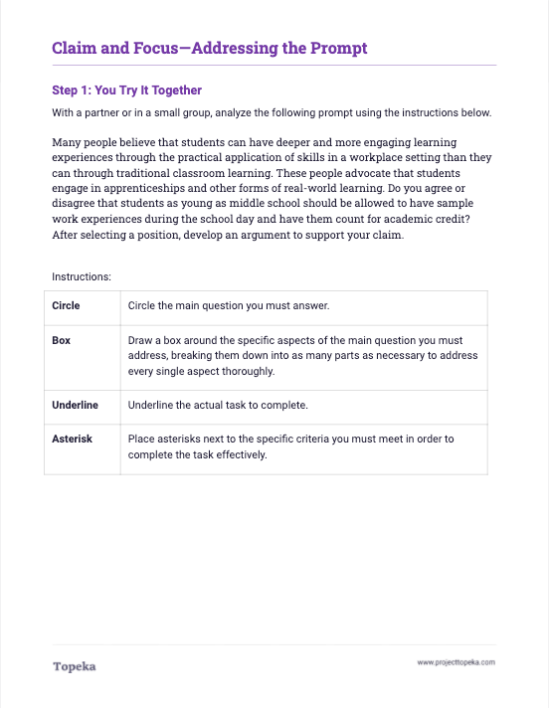
You do it together.
With a partner, analyze a prompt. Then write and evaluate a claim to respond to the prompt.
2
Notes:
Teachers will direct students to partner to complete step 1 of the exercise.

Slide 14
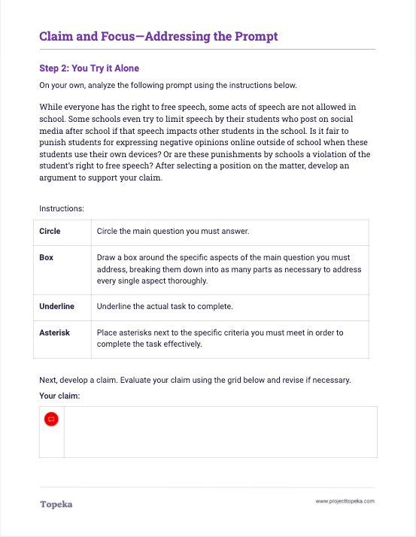
Independent Application
On your own, analyze another prompt. Then write and evaluate a claim to respond to the prompt.
2
Notes:
Teacher will direct students to complete Step 2 of the exercise independently.

