Slide 1
Day 1: A Vocabulary for Writing Arguments

Slide 2
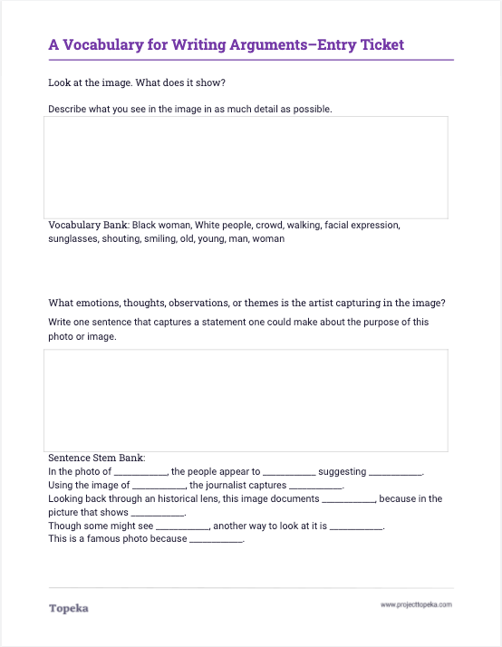
Analyze the image.
Complete the Entry Ticket using the photo provided.
2

Slide 3
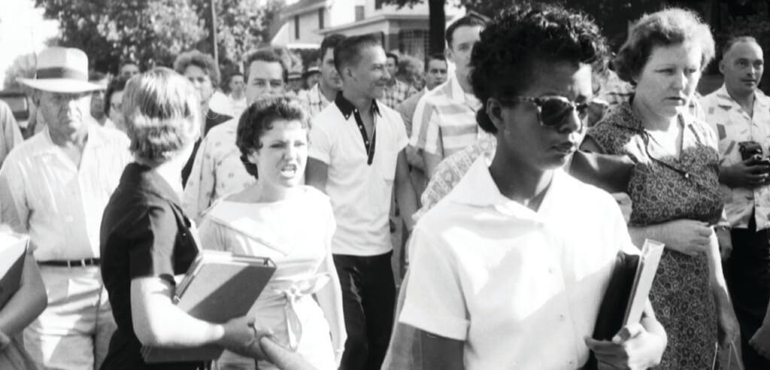
What realities of desegregation are captured in this photo?
“Little Rock Girl: 1957” captures a moment in the day of Elizabeth Eckford, on her first day of school. She was one of nine students desegregating Central High School in Little Rock, Arkansas in 1957.
Notes:
Upon completion of activity, teacher should invite students to turn and talk to a neighbor to discuss answers.
Discuss your answers with your neighbor. If you disagree, explain in greater detail how you came up with your answers. Using specific details from the image can make your answers more powerful. Remember, your interpretation is your own.

Slide 4
In this lesson you will learn…
what an argument is
a common vocabulary for writing arguments
Notes:
Teacher will set the purpose for the day by describing what will be covered.
The activity you just completed is going to help you make an argument about the photograph. In order to make a good argument, it’s helpful to understand some key terms for the components of an argument. So today, we’re going to learn first, what an argument is, and second, a common vocabulary for creating and discussing arguments.

Slide 5
What is an argument?
An argument is something we make to persuade others of our opinion or our position on an issue.
People make arguments to help others understand their ideas.
Notes:
Teacher will present concepts in the context of a review of the entry ticket.
In the entry ticket you answered a few questions about an image. The first question simply asked you to summarize what you saw. We’ll come back to that.
The second question asked you to interpret what you saw and to make a statement describing the “emotions, thoughts, observations, or themes” in the photo. Your response to this question is an argument: you have interpreted the photo one way, but someone else might interpret it another way.
An argument is something we make—it could be an essay, a video, a song, a picture, etc.—to persuade or convince others of our position on an issue. In this case, the “issue” is the meaning of the photograph. We make an argument to help others understand our ideas.

Slide 6




A Common Vocabulary
Terms to help you understand the rubric and write better arguments
Claim and Focus
Support and Evidence
Organization
Language and Style
Take an arguable stance on the issue and develop the essay around that stance.
Claim
Reasons
Explain relevant facts, definitions, and examples to back up the claim.
Evidence
Reasoning
Explain your position using transitions and a strong introduction and conclusion.
Organization
Transitions
Pay attention to using active words, a formal tone, and a variety of sentence structures.
Audience
Style
Notes:
Teacher will connect argumentation vocabulary words to rubric categories used for Revision Assistant automated scoring.
There are terms you can learn to help you think about and describe arguments that you want to make, and these same terms will help you understand the rubric that we’re working with for our argumentative essays. For example,
for the Claim and Focus rubric category, you need to understand what a Claim is and what Reasons are in order to understand how reasons help us maintain focus on our claim.
for the Support and Evidence category, you need to understand what Evidence is and how Reasoning is used along with evidence to prove your reasons.
This kind of vocabulary will also help you better understand organization and language and style. We will touch on these concepts today and explore them in greater depth later in the unit

Slide 7





Your Claim is your arguable stance. This stance will be the focus of your essay and will guide everything you write. You’ll maintain this focus by supporting your claim with clear Reasons.
You’ll back up your reasons using Evidence from the text.
A Vocabulary for Making Arguments
Your Reasoning is your explanation of how the evidence supports your reason and the claim you are making.
You will also acknowledge Counterarguments, or opposing viewpoints, and distinguish them from your own claim to add strength to your argument.
You’ll also pay attention to language and style, using words and sentences appropriate for your Audience.
Notes:
There is a helpful acronym that you can use to think about your arguments: CERCA, which stands for Claim, Evidence, Reasoning, Counterargument, and Audience. Think of these terms as your vocabulary for making arguments.
Teacher describes CERCA components using slide 7 contents.

Slide 8
Introduction and Claim
Use audience appealing language
Reason
Evidence
Reasoning
Fitting the Parts Together
Reason
Evidence
Reasoning
Counter-arguments to strengthen your arguments
Reason
Evidence
Reasoning
Conclusion
Notes:
These parts fit together to create an argument, as you see here. A strong argument begins with an introduction and claim, is supported by multiple reasons, each with evidence and reasoning, and ends with a conclusion. Knowing our audience helps us use appropriate language and style, and acknowledging counterarguments throughout our essay helps make our argument stronger.

Slide 9
What realities of desegregation are captured in this photo?
“Little Rock Girl: 1957” captures a moment in the day of Elizabeth Eckford, on her first day of school. She was one of nine students desegregating Central High School in Little Rock, Arkansas in 1957.
Notes:
Teacher returns to the entry ticket to label the parts of the argument applied to the image.
Let’s go back to the entry ticket and discuss the answers you found.
First, who can share their answer to the first question? What is shown in the image?
Teacher should ask for contributions describing factual details from the image, details that don’t require interpretation.
Now let’s look at the second question: “What emotions, thoughts, observations, or themes is the photographer capturing in the photo?” Who would like to share their “one statement”?
Teacher calls on student or teacher models making a claim about the photo. For example, “The image shows that different people had different reactions to desegregation.”
This statement is the claim. Your claim is your arguable stance that you’ll support with details from the image. Others might disagree or make a different claim.
Let’s see if we can support this claim with a reason: “The people in the crowd show different emotions.” One reason I think this is that while some people are showing anger on their screaming faces, others look silent. They are not expressing emotion. What other evidence can we point to in the photo to support this reason?
Teacher models or calls on students to describe details in the photo to support the reason. For example,
The young white woman is screaming at Elizabeth who says nothing back.
The other men and women are walking with the crowd. Some are smiling, but it is harder to see what the others are thinking.
Elizabeth’s eyes are covered with sunglasses, so it is hard to tell what her emotions are.
Teacher models or calls on students to provide reasoning to explain how details (evidence) support reason and claim. For example,
From these details we can see that people are reacting differently to this extremely intense moment.

Slide 10
The image “Little Rock Girl 1957 “ shows a group of protestors and others surrounding Elizabeth Eckert on her first day at a newly desegregated school. The image shows that the desegregation movement was full of hatred, danger, and courage. One reason for this is the body language of the young white woman who is screaming at Elizabeth. In the photograph viewers can see that the young woman is full of hate. Elizabeth is not screaming back, but walking ahead.
From these details viewers can see that some people were very opposed to desegregation and that the black students who went to the school were very courageous because they faced a lot of danger.
Introduction
Example:
A One- Paragraph Argument
Claim
What emotions, thoughts, observations, or themes is the photographer capturing in the photo?
Evidence
Reasoning
Notes:
Teacher shows 1-paragraph argument based on image to show how claim, reason, evidence, reasoning fit together.
Let’s look at this example again. This paragraph introduces the photo with a summary of the image. The sentence highlighted in red makes the claim. The claim is supported by one reason. The details, highlighted in yellow, are the evidence, and the orange reasoning is an explanation of how the evidence connects to the claim.
Teacher calls on students in large group and asks students to make a different claim about the photograph, either new or from the entry ticket.
“Can you make a different argument about the emotion conveyed in this image?”
Teacher asks students to support the new claim using details from the photo and to explain how the details suggest that meaning.

Slide 11
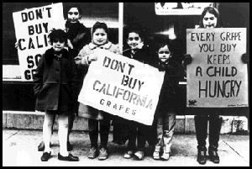
You do it together.
First, analyze the photo. Then work together to find details and build an argument.
Notes:
Distribute activity and divide students into pairs or groups. Explain the activity.
Now we will do the same thing in groups using another image. In the first step you’ll do the image analysis and in the second step you’ll work together to write a one-paragraph argument.
Teacher will circulate to support students.

Slide 12
Independent Application
Working individually, find additional details to support the same claim or take a different position.
Notes:
Teacher will direct students to work individually to write another paragraph.
Now that you’ve carefully analyzed the details in the image, find another reason that supports your claim and provide evidence. Or make a different claim about the image and support it with a new reason and evidence.

