Slide 1
Organization
Intervention Lesson

Slide 2
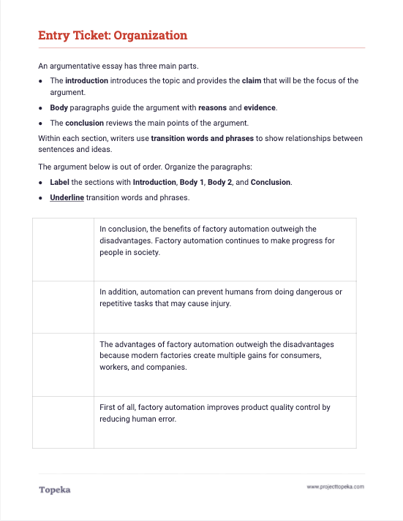
Entry Ticket
Complete the activity to put the argument in order.
2
Notes:
Upon completion, teacher should invite students to turn and talk to a neighbor to discuss their answers. Sample script:
Take a moment to talk to your neighbor about the organization and transition words you identified. Explain your answers to your partner.

Slide 3
In this lesson, you will learn…
what are the basic parts of an argument
how parts of an argument are organized
how transition words help make an argument’s organization clear
Notes:
Teacher sets purpose for the lesson by describing what will be covered in class session.
In this lesson you will learn what are the basic parts of an argument, how those parts are organized, and how transition words help make an argument’s organization clear.

Slide 4
Parts of an Argument
Arguments start with an introduction, which should contain a summary and a claim.
The claim creates the focus for the body of the argument, which contains reasons and evidence to support the claim.
The argument ends with a conclusion, which recaps the main points and calls readers to action or provides final insights on the topic.
Notes:
Teacher provides brief description of each part. See slide for text.
Every argument has three basic sections: the Introduction, Body, and Conclusion. Arguments start with the introduction, which should contain a summary and a claim.
The claim creates the focus for the body of the argument, which also contains reasons and evidence to support the claim.
The argument ends with a conclusion, which recaps the main points and calls readers to action or provides final insights on the topic.

Slide 5
Basic Organization
Introduction
Summary & Claim
Body
1st Paragraph
Reason, Evidence & Reasoning
2nd Paragraph
Reason, Evidence & Reasoning
3rd Paragraph
Reason, Evidence & Reasoning
Conclusion
Notes:
Teacher walks through how these parts look when placed in an outline.
For example:
This is an outline of a brief argumentative essay. At the very beginning you have the introduction, which must contain your claim, and should contain an brief explanation or summary of the “ongoing issue.”
After the introduction comes the body, which contains your reasons. Each reason paragraph should provide evidence and an explanation of how the evidence connects to the reason and claim. This explanation is your reasoning.
Finally you have a conclusion. Your conclusion should wrap up the argument. It should restate your claim and provide the brief summary of how you proved your position.
Teacher returns to the entry ticket.
Let’s return to the entry ticket activity. The introduction to this argument is “The advantages of factory automation outweigh the disadvantages because modern factories creates multiple gains for consumers, workers, and companies.” How do I know this? Because this paragraph provides the claim.
At the end of the essay is the conclusion. The conclusion sums up all of the information you have presented about your claim.
What conclusion did you identify in the entry ticket? How did you know?
In your conclusion you should restate your claim. A strong conclusion will summarize how you proved or defended your claim and encourage readers to agree or take action, or give them a final thought to take away.
What is the final thought in the sample from the activity?

Slide 6
Introduction:
Summary and Claim
Parts of an Argument
Reason
Evidence
Reasoning
Reason
Evidence
Reasoning
Reason
Evidence
Reasoning
Conclusion
Notes:
In between the introduction and conclusion are the body paragraphs. This is where you present the reasons and evidence for your claim and explain with reasoning how your reasons and evidence connect to the claim.
Take a look at this graphic. In a typical argument, within each of the body paragraphs, there will be a reason, then evidence from the text or quotation, and then reasoning that provides an explanation of how the reason and evidence connect to each other and to the claim.

Slide 7
Adding Transitions
Transitions are words and phrases that help connect the ideas in your argument.
If people exercise, then they will be healthier. There are different types of physical activity that a person could do on a daily basis. For example, a person could walk to work or school. Therefore, all people should try to exercise every day.
Good transitions can help show how you’ve organized your argument.
Notes:
Once you have organized your essay, you can add transitions to show even more clearly how your ideas are connected. Transitions work well to connect ideas within a paragraph, as shown here.

Slide 8
Transitions to Show Organization
To show order
To show importance
To contrast ideas
First of all…
Next…
Finally…
Above all…
Mainly…
More importantly…
Surely…
Some argue… However…
On one hand… On the other hand…
On the contrary…
Nevertheless…
Notes:
They can also help show the organization and connection between paragraphs. For example, in the entry ticket, the two body paragraphs began with transition words, “First of all” and “In addition,” indicating the order in which the ideas should be considered.

Slide 9
You can improve an essay’s organization using a simple checklist:
Ask:
If not,
Is there an introduction and conclusion to give the essay focus?
add the missing components.
Revising for Organization
Does each body paragraph focus on a single reason?
break new ideas into new paragraphs.
Are the paragraphs in logical order?
rearrange paragraphs.
Do the paragraphs and sentences flow well from one idea to another?
insert transition words and phrases.
Notes:
Teacher presents revision checklist
In a moment you will receive instruction to help you plan a revision of your essay. Generally speaking, this is great way to look at your essay’s organization.
You can improve an essay’s organization by using a simple checklist and asking yourself a series of questions. The answers to those questions will help you to improve your essay.
Teacher should refer to slide to present the items in the checklist.

Slide 10
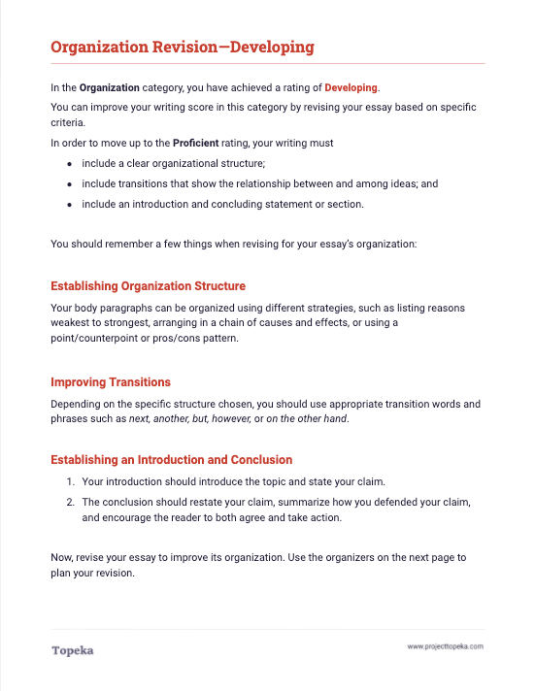
Revising for Organization
Review the revision instructions for your essay submission. Revise your work and resubmit.
2
Notes:
Teacher distributes leveled revision instructions to students according to their individual score reports.
Teacher instructs students to use the revision instructions to guide a revision of the organization of their essays.
Using your table from the entry ticket and the revision instructions I’ll give you, you’ll plan a revision and revise your essay.

