Slide 1
Support and Evidence
Intervention Lesson

Slide 2
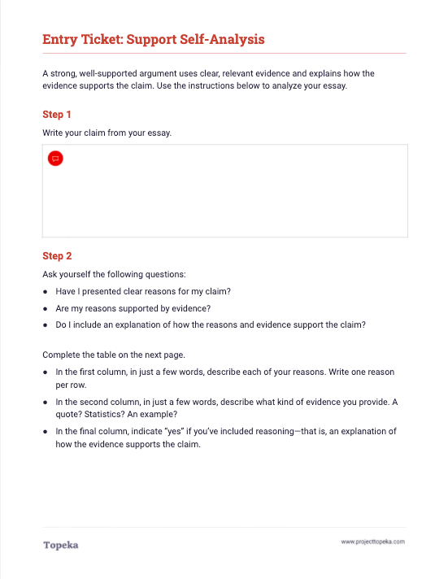
Entry Ticket
Identify the reasons and evidence you provided in your essay. Are there holes you need to fill?
2
Notes:
Teacher sets the purpose for the class with an entry ticket to activate prior knowledge. Teacher distributes entry ticket to students. Students will need access to their draft essays.
Upon completion, teacher should invite students to turn and talk to a neighbor to discuss their answers. Sample script:
“Take a moment to talk to your neighbor about the support and evidence you were able to identify in your own essay. Explain your answers to your partner.”

Slide 3
In this lesson, you will learn…
how evidence and reasoning support an argument
what kind of evidence to use
how to revise your essay to improve your support and evidence
Notes:
Teacher sets purpose for the lesson by describing what will be covered in class session.
Today we are going to revisit the concept of supporting your claim with reasons and evidence.
You’ve just completed an entry ticket that asked you to outline the support you included in your first draft. We’ll talk briefly about the concepts of reasons, evidence, and reasoning; remind ourselves of what makes good evidence; and then you’ll each plan a revision to see if you can improve the support and evidence in your essay.

Slide 4



Summary and Claim
Reason
Evidence
Reasoning
Arguments are built on reasons and evidence.
Reason
Evidence
Reasoning
Reason
Evidence
Reasoning
Conclusion
Notes:
Teacher introduces the purpose and placement of support and evidence in an argumentative essay.
Arguments are built on reasons and evidence.
When you are making an argument, you are taking a position that you want others to accept or understand. That position is your claim.
But it’s not enough to just make a claim. You have to support your claim with reasons why you make the claim and evidence that proves your reasons are valid. You also need an explanation—your reasoning—describing how the evidence connects to the reason and back to the claim. Your reasoning links everything together.
Teacher explains support for a claim in the context of reviewing the entry ticket.
In the entry ticket, the first column that you filled out contained your reasons. Hopefully you were able to see how your reasons created an overall structure or organization for your essay, much like the graphic here. If not, that’s something you can work on in your next draft.
For each of the reasons in your essay, you were asked to describe one or more pieces of evidence in the second column.

Slide 5
How do you support a claim with evidence?
Successful arguments use well-organized reasons and provide evidence to prove those reasons and support the claim.
Evidence comes from reliable sources. Examples from real life can also be used as evidence as long as anyone has access to proving or accepting those examples.
Notes:
Teacher continues:
Successful arguments use well-organized reasons and provide evidence to prove those reasons and support the claim.
Evidence can be facts or statistics, quotations from the text, or examples from real life. Your evidence should come from reliable sources.

Slide 6

What makes good evidence?
Good evidence is…
Relevant
Appropriate
Valid
Related to the topic
Closely connected to the reason
Not outdated
From a trustworthy source
Closely connected to the focus of claim
Closely connected to the reason it supports
Accurate
True
From reliable and authoritative sources
Notes:
Teacher continues:
So what makes good evidence?
Good evidence is relevant: it is related to the topic, closely connected to the reason, and not outdated.
Good evidence is appropriate: it is from a trustworthy source, it is closely connected to the focus of the claim, and it is closely connected to the reason it supports.
Good evidence is also valid: it is accurate, true, and from reliable and authoritative sources.

Slide 7
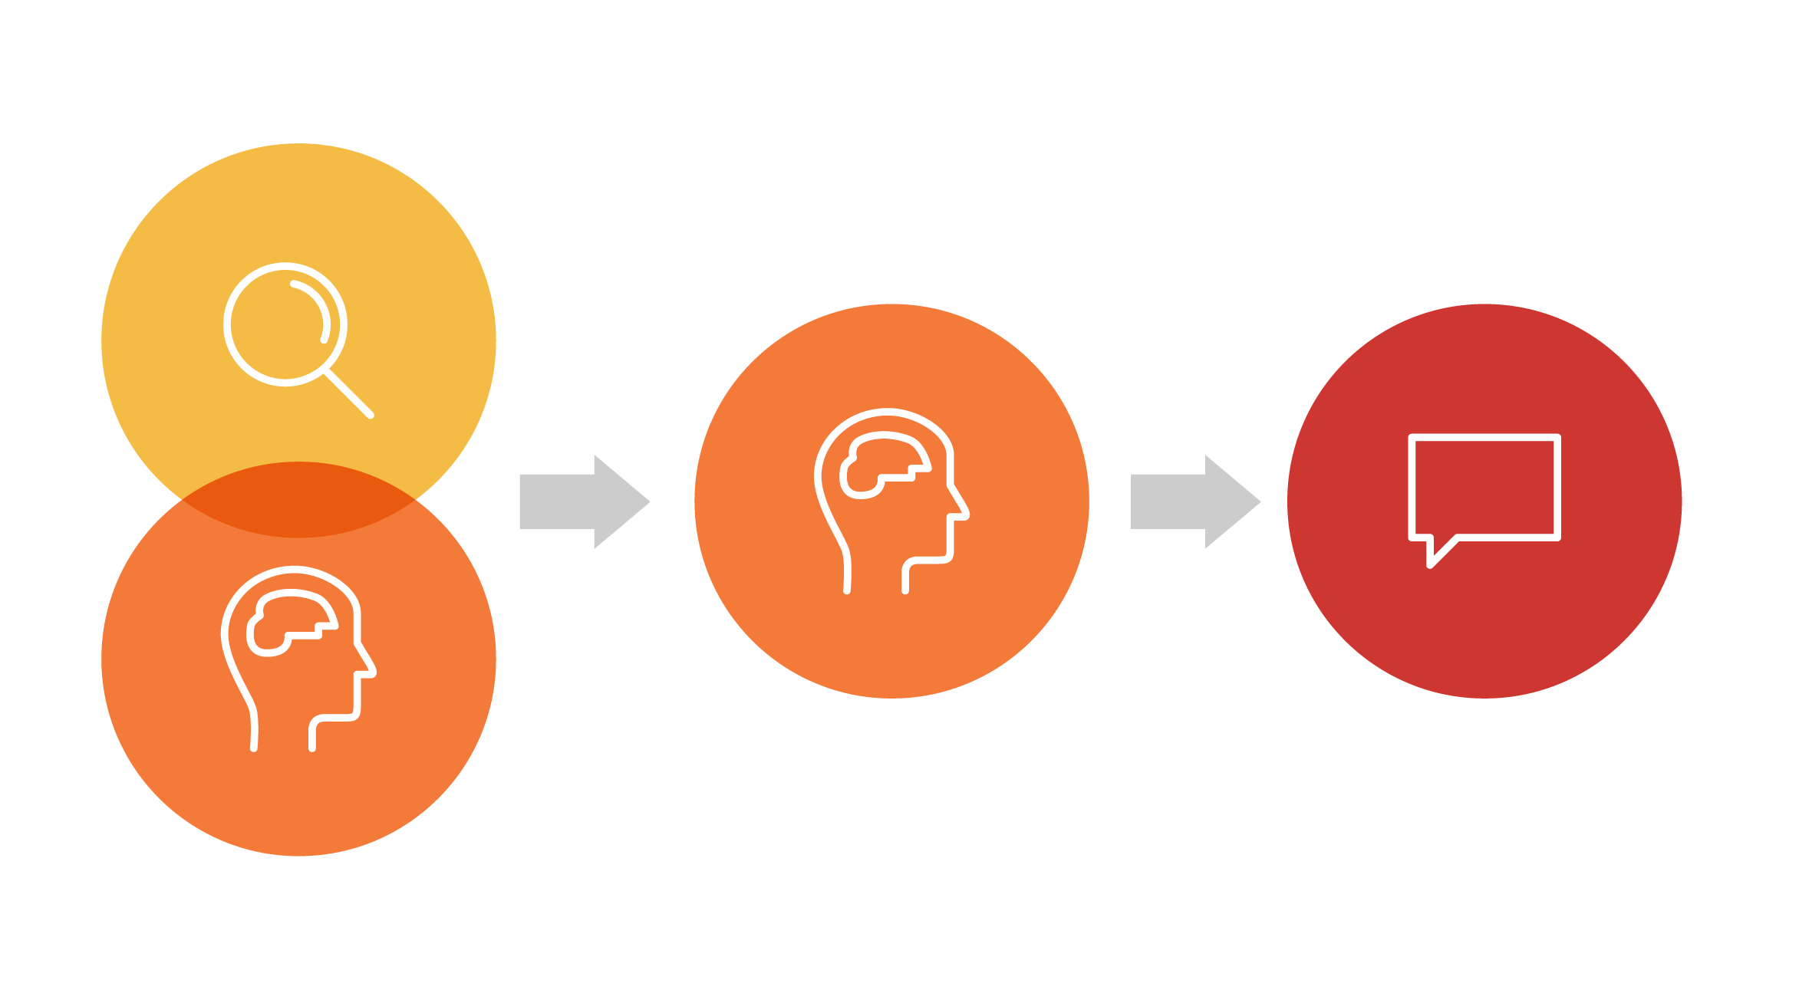
What is reasoning?
Reasoning is an explanation of how your evidence proves your claim.
It provides the connection between your claim, the main reasons you support the claim and your evidence.
Evidence and Reasoning
Reason
Claim
Notes:
Reasoning is your explanation of why your reason and evidence are relevant to the claim. Reasoning connects everything together.
You can’t assume that when you provide a reason and evidence to support your claim that everyone will understand what you mean. Your reasoning is an explanation that links the pieces together and shows you know what you’re writing about.

Slide 8
Reason
Having a dog forces people to go outside to take their dogs for a walk.
For example…
Evidence
According to the article, people who have dogs walk 22 minutes more per day than people who don’t have dogs.
Claim: While some people argue that cats make better pets than dogs, dogs are clearly the better pets.
Reasoning
That means people who own dogs are healthier because they are walking outside more than people who have cats, which don’t need to go for walks.
Notes:
Teacher provides an example of support without and with evidence and reasoning.
For example, if I were making an argument about why dogs are better pets than cats, one of my reasons might be that having a dog forces people to go outside to take their dogs for a walk.
Well, it’s certainly not clear from that why dogs are better pets than cats. I’m going to need to say more about that reason. So I’ll add evidence: “According to the article, people who have dogs walk 22 minutes more per day than people who don’t have dogs.“
OK, so now I have a statistic there, but how does this reason and this evidence connect back to the claim that dogs are better pets than cats?
That’s where the reasoning comes in: “That means people who own dogs are healthier because they are walking outside more than people who have cats, which don’t need to go for walks.”
This line of reasoning connects the evidence back to the reason and the claim.
You should not include reasons without evidence or leave evidence unexplained.

Slide 9
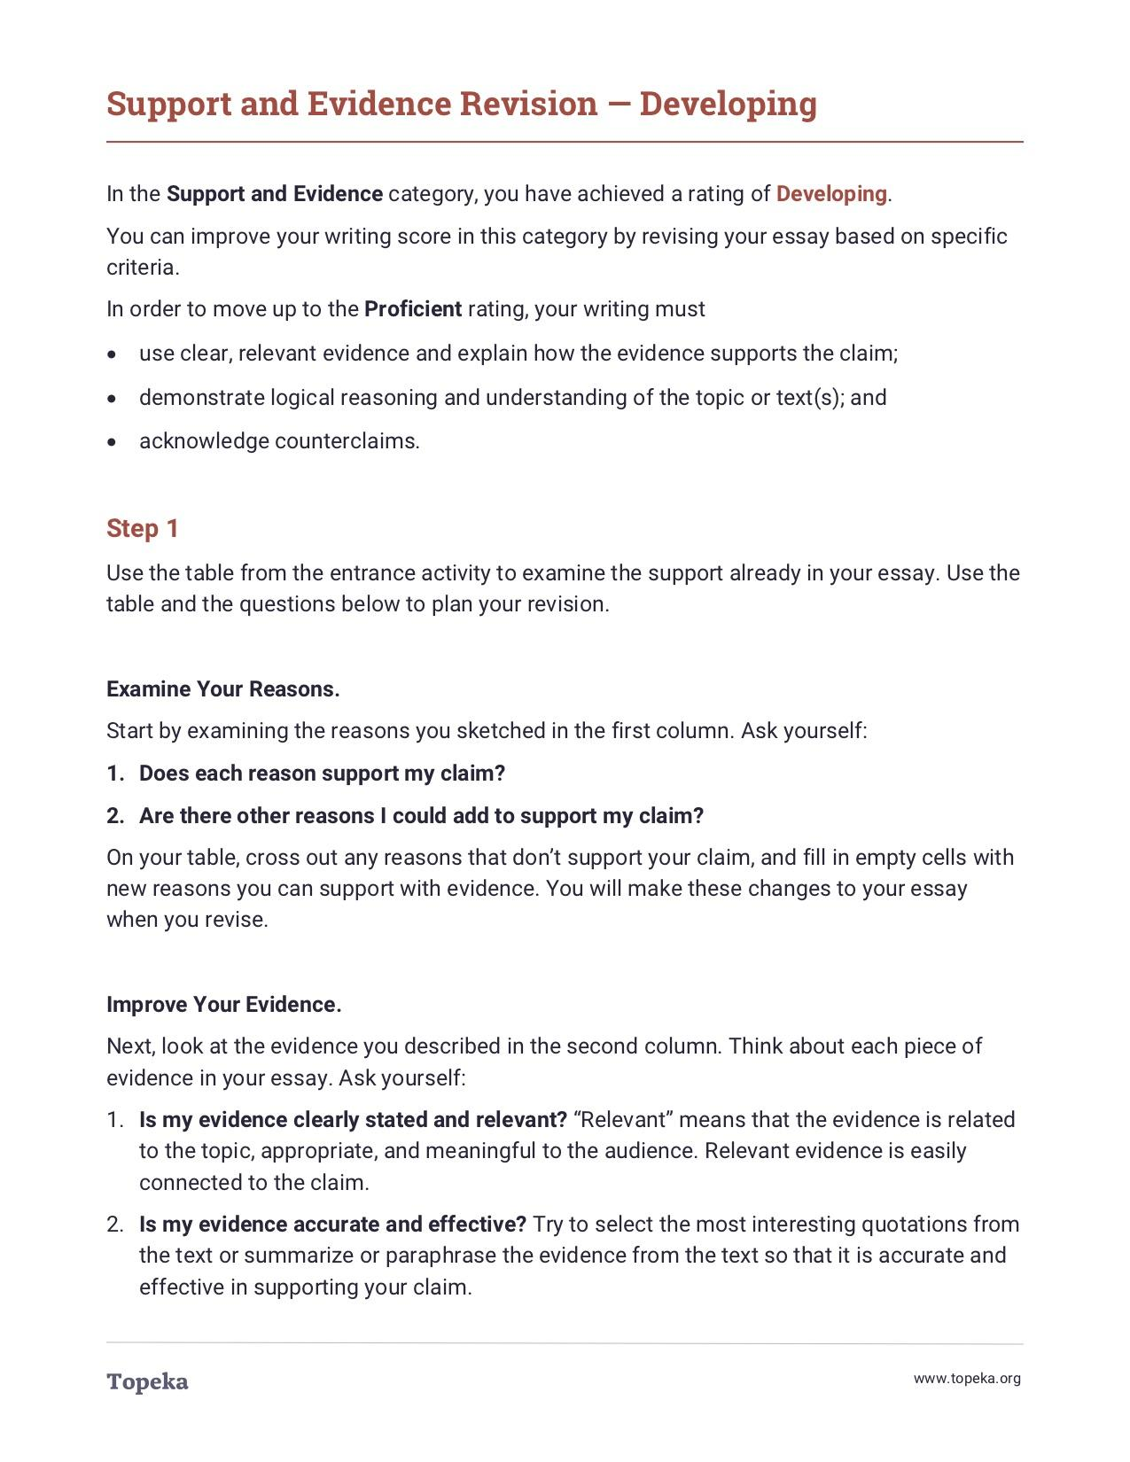
Revision
Activity
Use your analysis from the entry ticket and the revision instructions to plan a revision of your essay.
2
Notes:
Teacher distributes leveled revision instructions to students according to their individual score reports.
Teacher instructs students to use the revision instructions to plan a revision of the support and evidence in their essays.
Now, using your table from the entry ticket and the revision instructions I’ll give you, you’ll plan a revision and revise your essay.
Teacher circulates to support students through their individual revisions, sandwiching areas for improvement between positive elements. For example:
You selected a great example as evidence. However, your next sentence doesn’t help the reader understand how your example connects to the main reason of your paragraph. Adding a sentence of reasoning to your evidence would make your reason more powerful.

