Slide 1
Support and Evidence
Introducing Exemplars

Slide 2
Revising an Exemplar Essay
What will you see in this exemplar lesson?
Draft
Strategies
Revision
A sample first draft of an essay
Specific actions a writer can take to improve the support and evidence for a draft
A sample revision of the exemplar essay using action steps
Notes:
Teacher will set a purpose for the lesson by describing what students will encounter.
In this lesson, we’re going to look at the process of revising an essay to improve performance in the support and evidence domain.
First, we will look at a sample first draft alongside the revision strategies for this domain. You will use the strategies sheet to make suggestions for improving the sample first draft.
Then, we’ll look together at specific revision steps a teacher suggested for this essay, and we’ll try to implement those steps for the sample essay.
Finally, we’ll see a sample revision to see how the writer used those specific action steps to improve the support and evidence of the draft.

Slide 3
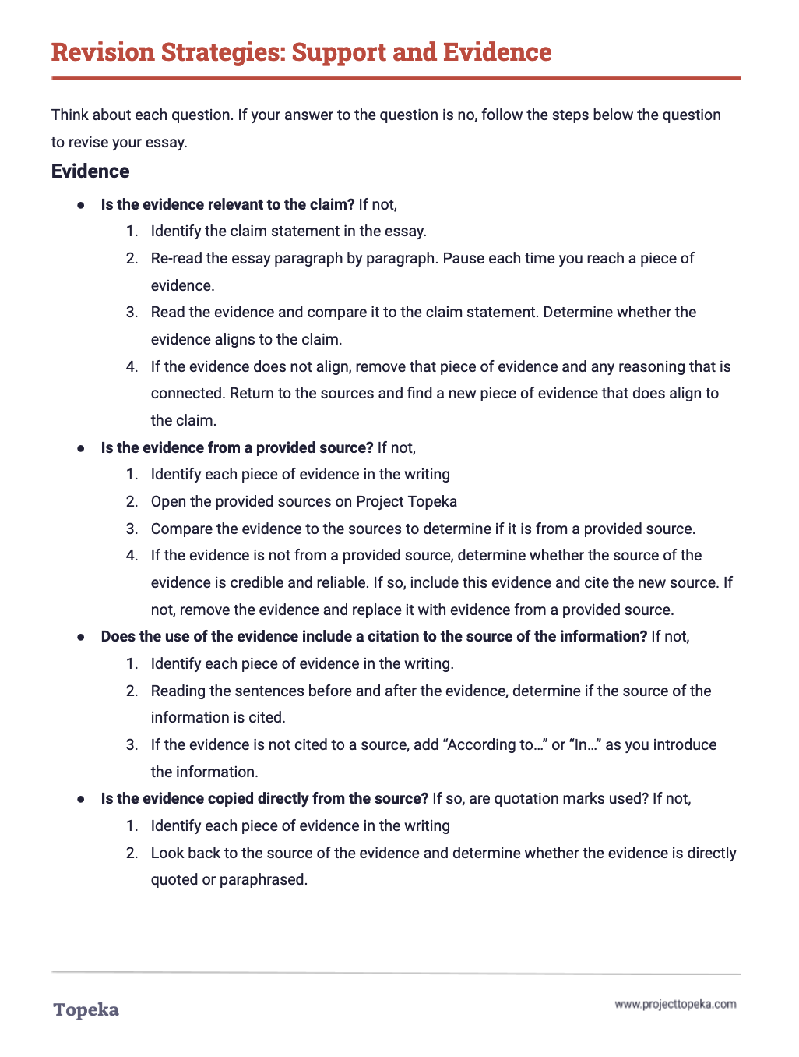
Revision Strategies: Support and Evidence
Review the revision strategies sheet for support and evidence.
2
Notes:
Teacher distributes Revision Strategies Sheet: Support and Evidence.
Take a moment to review the Revision Strategy Sheet for Support and Evidence. Think back to what you know about support and evidence—about what reasons and reasoning are, and how good evidence supports your claim.
Teacher has students Pair and Share with a classmate to confirm their understanding of what support and evidence means and how it is evaluated.
Teacher distributes the handout Support and Evidence Exemplar: Before Revision. Teacher directs students to look at the first page.
Here is an example of a student writing about school uniforms. The question the student is answering is whether or not dress codes create a more positive school environment than uniforms or no policy at all.
Using the Revision Strategies Sheet: Support and Evidence, suggest revisions that would strengthen the writer’s achievement in the support and evidence domain. Annotate the draft to show your suggestions and your explanation.
When students complete the review, teacher has students partner with others to compare the suggested changes. Have students explain their suggestions:
How do these changes increase student achievement on the support and evidence section of the rubric? Why do you think the revised essay will be better?

Slide 4
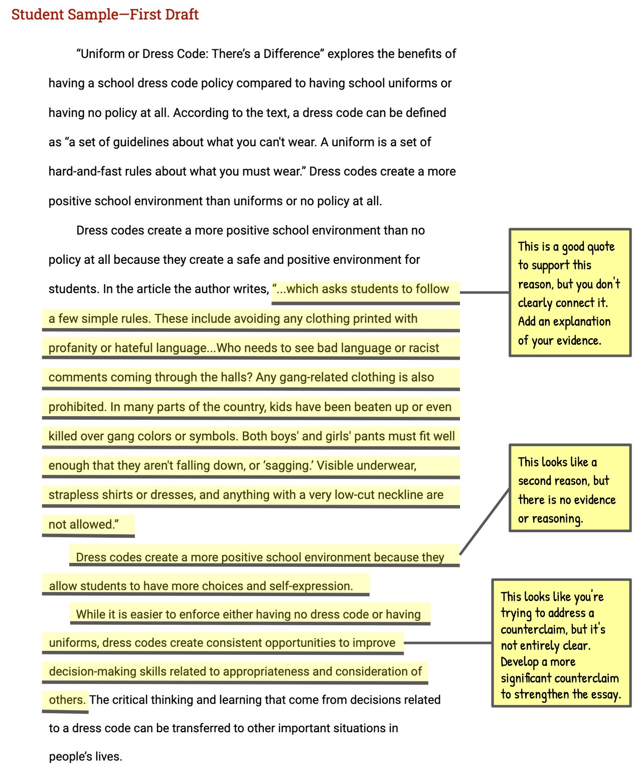
Exemplar First Draft
Review the suggested changes.
Notes:
Teacher directs students to the second page of the Support and Evidence Exemplar: Before Revision handout and explains the annotations.
After reviewing this piece of writing, I can see that the writer has included reasons and some evidence, but it’s not always complete or clearly connected.
If I look at the revision strategies sheet, I can see that the support and evidence rubric domain can be broken down into three traits: Evidence, Support, and Counterclaims.
I’m going to ask myself some of these questions to get ideas for how to revise my essay. “Is the evidence supported by a reasoning sentence connecting the evidence to the reason and the claim?” I can see in each of these ‘before” revision paragraphs, the writer hasn’t always introduced evidence or explained evidence.
For example, in the first body paragraph the writer gives a reason and a quote, but there is no explanation linking the quote back to the reason and to the claim. So the annotation says that the writer should add a reasoning statement.
Using the annotated first draft, teacher will continue to review the suggested changes, ask students to evaluate their impact, and also answer questions related to the domain’s evaluation criteria.
Do you think these suggestions will help improve the students score on support and evidence? Where else do you think the writer can strengthen the essay’s support and evidence? What other suggestions do you think would help this essay and why would these changes improve the strength of the support?

Slide 5
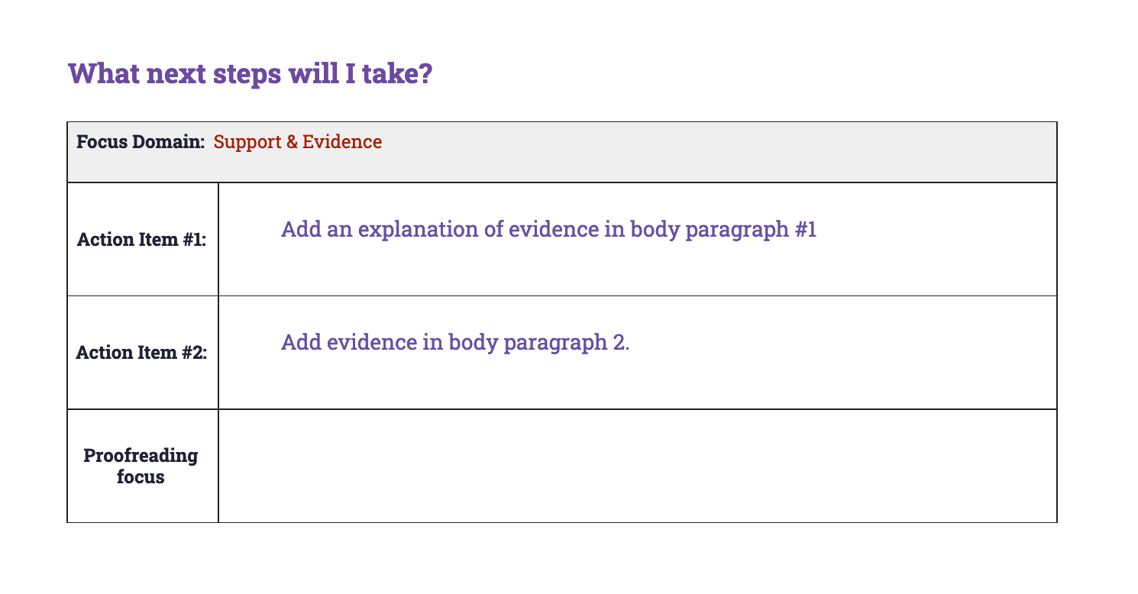
Sample Conference Record
Notes:
Teacher describes how a conference record is used to convey suggested revisions.
Here is an example of a conference record conveying the same strategies the teacher suggested in the annotations.
Teacher continues:
In the top row, we see that the writer is going to address evidence and support. Let’s look again at the revision steps provided to this writer.
The first strategy, as we saw in the annotations is to add an explanation of the evidence in body paragraph 1.
Adding evidence to body paragraph 2 becomes step 2, because there was previously no evidence to support that reason.
Another possible action item is to develop a more significant counterargument.
Which two would you focus on?
Teacher directs students to work in small or large groups to review the recommendations and discuss the impact of these revisions. If time allows, students can implement the suggested revisions.

Slide 6
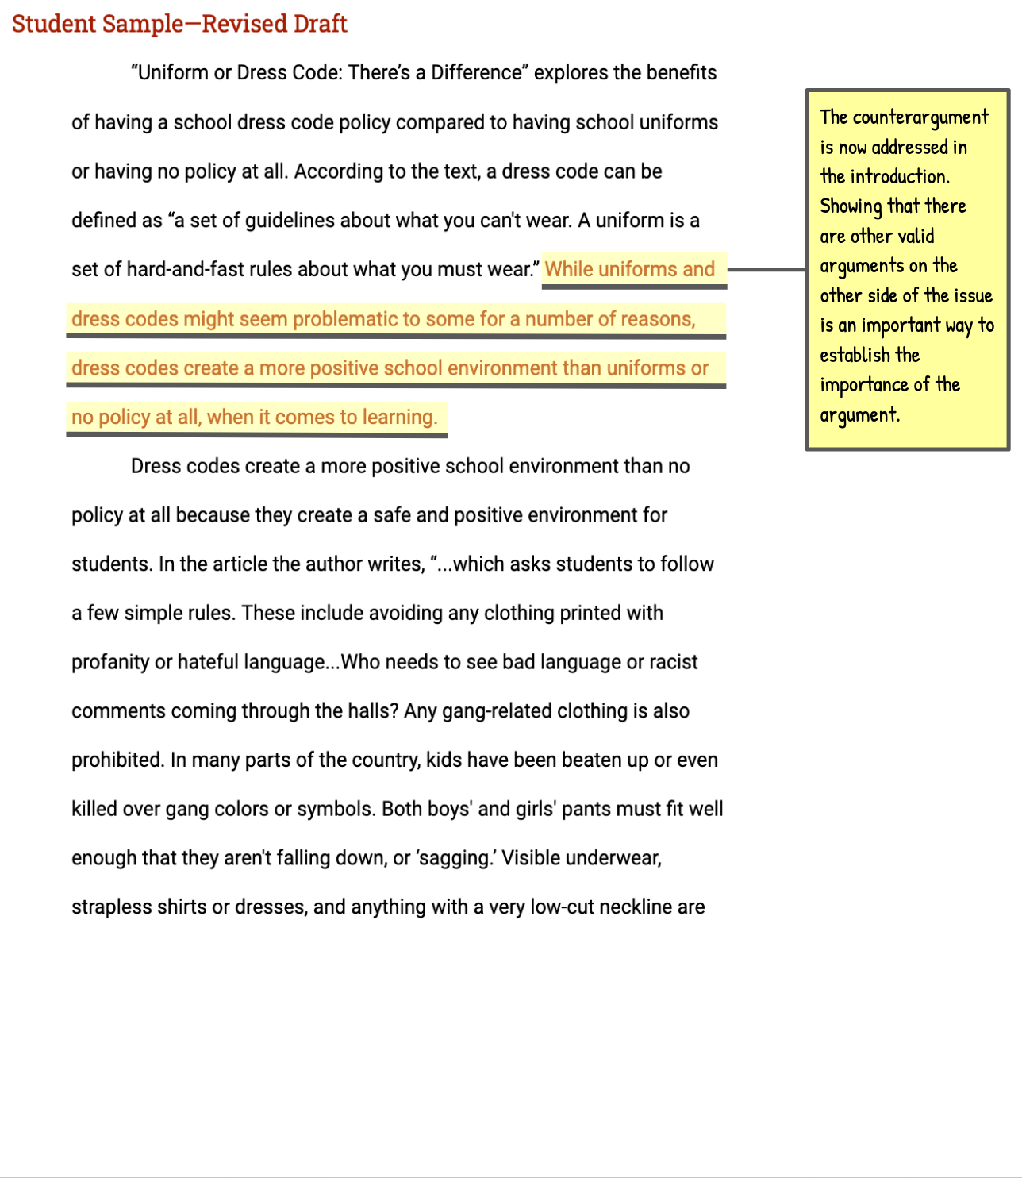
Exemplar Revision
Assess the writer’s revisions
Notes:
Teacher distributes the Support and Evidence Exemplar: After Revision and directs students’ attention to the first page of the revised essay.
In this revised draft, the writer has responded to the action steps the teacher presented in the conference form. This draft models all three possible revisions so you can see how each could be addressed. Review these revisions to see if you understand their impact. Follow the instructions on the handout.
Teacher allows students time to read revised essay and react to the revisions.
Teacher directs students to turn attention to the revised essay. Teacher thinks aloud to describe impact of revisions.
What do you notice about the differences in this text based on the highlighted sentences? How have these changes strengthened the essay’s support and evidence?
If you read the sentences highlighted in red, you will see that the writer has added text in multiple places to strengthen the essay. For example, in the introduction, the writer acknowledges the counterargument by adding, “While uniforms and dress codes might seem problematic.” By adding this brief phrase, the writer acknowledges the counterargument early on, and they do the same thing again in the conclusion, which strengthens the overall argument.
In the same way, the writer has introduced new text in the body paragraphs, first to explain existing evidence, and then to introduce and explain new evidence.
Refer to the annotated version of the revised sample for additional commentary on revisions.
Teacher continues to describe revisions and concludes by reminding students to apply revision strategies to their own essays.
When you’re revising your essay, remember to use these helpful revision strategies to take your essay to the next level.

