Slide 1
Claim and Focus
Introducing Exemplars

Slide 2

Revising an Exemplar Essay
What will you see in this exemplar lesson?
Draft
Strategies
Revision
A sample first draft of an essay
Specific actions a writer can take to improve the claim and focus of a draft
A sample revision of the exemplar essay using action steps
Notes:
Teacher will set the purpose for the lesson by describing what students will encounter.
In this lesson, we’re going to look at the process of revising an essay to improve performance in the claim and focus domain.
First, we will look at a sample first draft alongside the revision strategies for this domain. You will use the strategies sheet to make suggestions for improving the sample first draft.
Then, we’ll look together at specific revision steps a teacher suggested for this essay, and we’ll try to implement those steps for the sample essay.
Finally, we’ll see a sample revision to see how the writer used those specific action steps to improve the claim and focus of the draft.

Slide 3
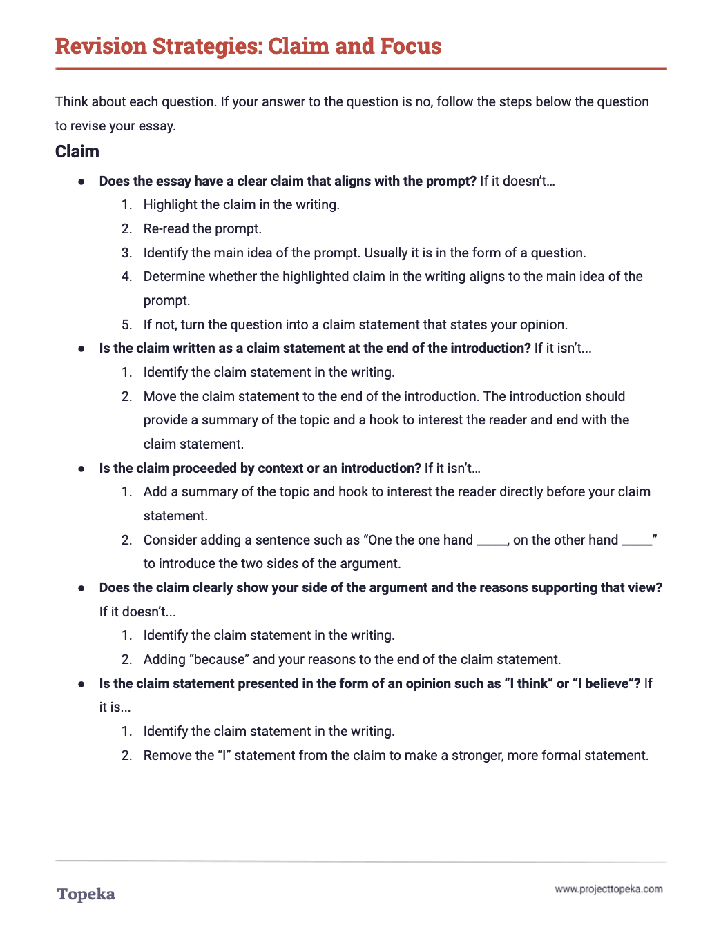
Revision Strategies: Claim and Focus
Review the revision strategies sheet for claim and focus.
2
Notes:
Teacher distributes Revision Strategies: Claim and Focus.
Take a moment to review the revision strategy sheet for claim and focus. Think back to what you know about claim and focus—about what makes a strong claim, and how a strong claim helps focus an essay.
Teacher has students Pair and Share with a classmate to confirm their understanding of what claim and focus means and how it is evaluated.
Teacher distributes the handout Claim and Focus Exemplar: Before Revision. Teacher directs students to look at the first page.
Here is an example of a student writing about school uniforms. The question the student is answering is whether or not uniforms empower students in ways that help them learn.
Using the revision strategies for claim and focus, suggest revisions that would strengthen the writer’s achievement in the claim and focus domain. Annotate the draft to show your suggestions and your explanation.
When students complete the review, teacher has students partner with others to compare the suggested changes. Have students explain their suggestions:
How do these changes increase student achievement on the claim and focus section of the rubric? Why do you think the revised essay will be better?

Slide 4
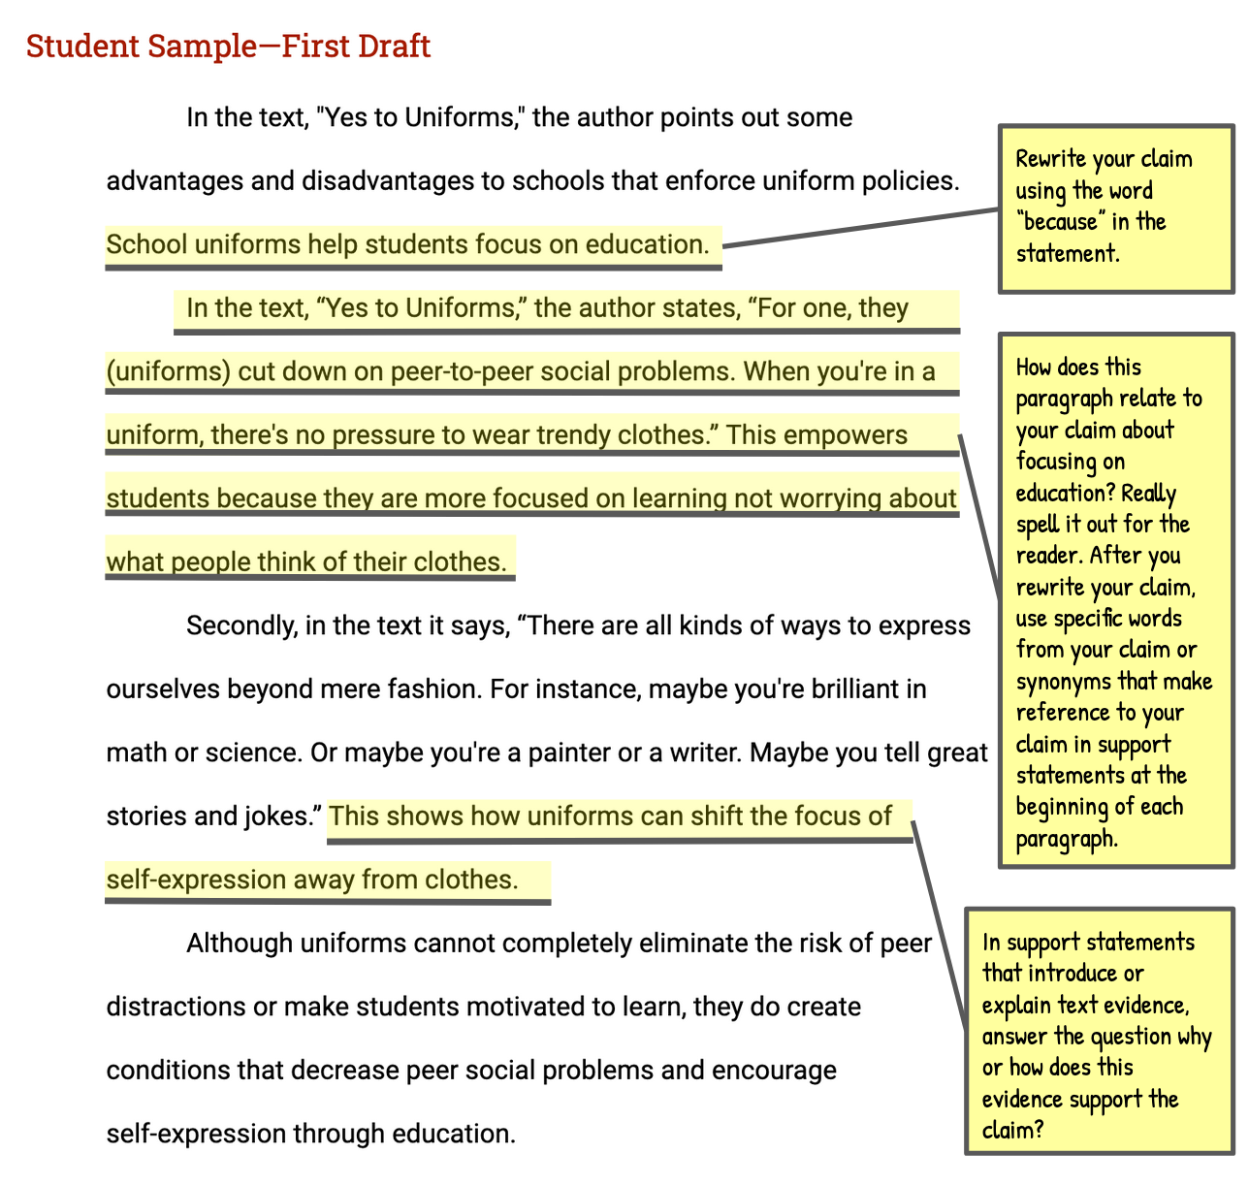
Exemplar First Draft
Review the suggested changes.
Notes:
Teacher directs students to the second page of the Claim and Focus Exemplar: Before Revision handout and explains the annotations.
After reviewing this piece of writing, I can see that the claim is there and it’s related to the topic, “school uniforms help students focus on education.” But the other paragraphs aren’t always so clear in what they’re trying to prove.
If I look at the revision strategies sheet, I can see that the claim and focus rubric domain can be broken down into two traits: one is claim and the other is focus.
I’m going to ask myself some of these questions to get ideas for how to revise my essay. “Does the claim include both a side of the argument and reasons supporting that view?” I have a claim but it doesn’t include my reasons. Adding the word “because” to the end of the claim would allow the writer to make the claim more specific by indicating the specific reasons that will be discussed in the essay.
Using the annotated first draft, teacher will continue to review the suggested changes, ask students to evaluate their impact, and also answer questions related to the domain’s evaluation criteria:
Do you think these suggestions will help improve claim and focus? Where else do you think the writer can strengthen the essay’s claim and focus? What other suggestions do you think would help this essay, and why would these changes improve the strength of the claim or focus?

Slide 5
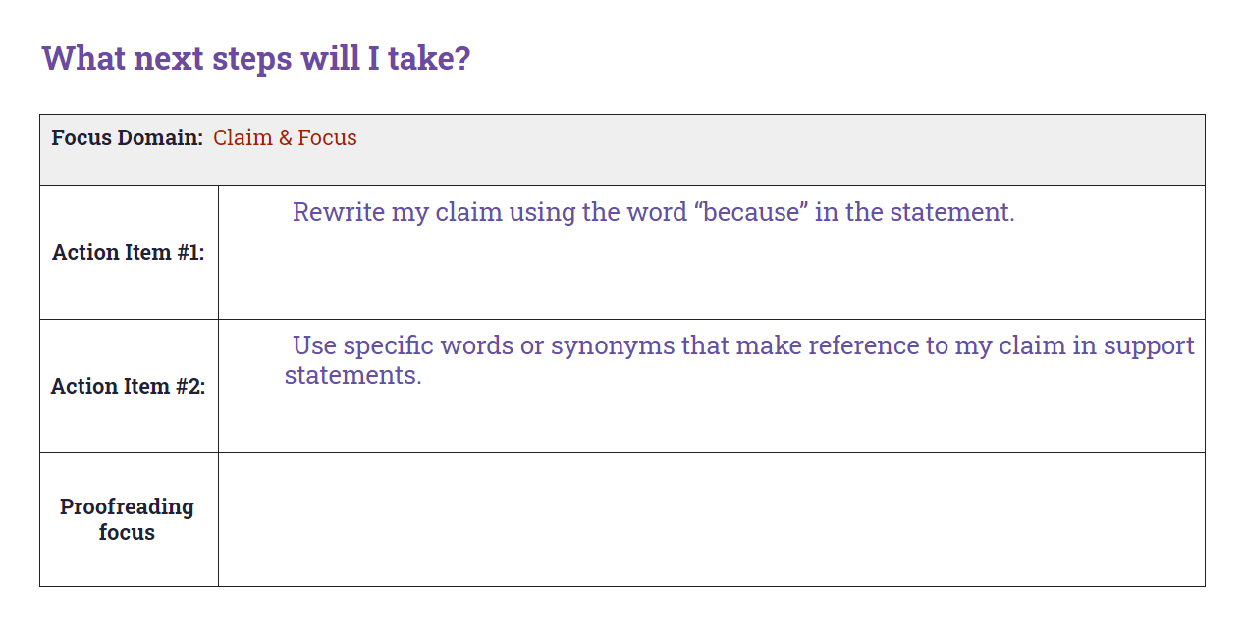
Sample Conference Record
Notes:
Teacher describes how a conference record is used to convey suggested revisions:
Here is an example of a conference record conveying the same strategies the teacher suggested in the annotations.
Teacher continues:
In the top row, we see that the writer is going to concentrate on improving both the claim and the focus traits. Let’s look at again at the revision steps this writer could use.
The first strategy, as we saw in the annotations, is to indicate the reasons why you support your claim directly within your claim statement. So here the first step is to rewrite the claim using the word “because.”
Another strategy is using specific words from the claim. Remember, this helps link reasons within the essay back to the claim statement.
Finally, focusing on answering the question in every support statement, “how or why does this evidence support the claim?”
This reinforces the links between the evidence, the reason, and the claim.
Which two would you choose to focus on?
Teacher directs students to work in small or large groups to review the recommendations and discuss the impact of these revisions. If time allows, students can implement the suggested revisions.

Slide 6
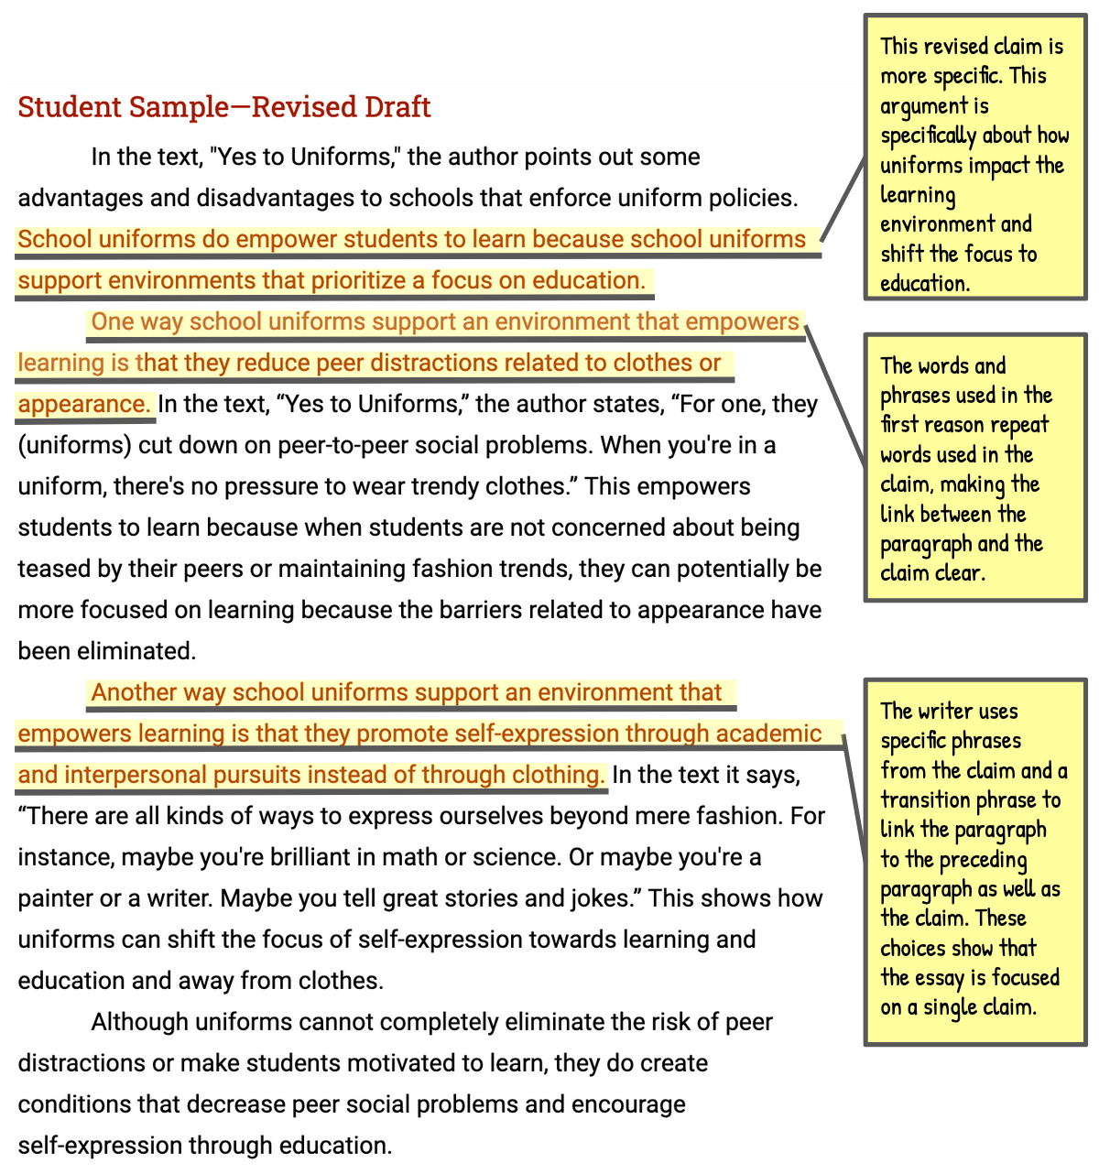
Exemplar Revision
Assess the writer’s revisions.
Notes:
Teacher distributes the Claim and Focus Exemplar: After Revision and directs students’ attention to the first page of the revised essay.
In this revised draft, the writer has responded to the action steps the teacher presented in the conference form. This draft models all three possible revisions so you can see how each could be addressed. Review these revisions to see if you understand their impact. Follow the instructions on the handout.
Teacher allows students time to read revised essay and react to the revisions.
Teacher directs students to turn attention to the revised essay. Teacher thinks aloud to describe impact of revisions.
What do you notice about the differences in this text based on the highlighted sentences? How have these changes strengthened the essay’s claim and focus?
If you read the sentences highlighted in red, you will see that the claim is now more specific and more arguable. Adding the specific reference to the impact on the environment to help students focus on learning made the claim stronger than it would have been had the writer simply answered the prompt by turning it into a statement.
Later, in each paragraph supporting the claim, reasons link directly back to the claim by referring to “the learning environment.” Reasoning statements that explain evidence are also linked directly back to this idea as they explain why the uniforms support the learning environment by helping students focus on the academic parts of school versus other social elements that can impact students’ experience of school.
Teacher continues to describe revisions and concludes by reminding students to apply revision strategies to their own essays.
When you’re revising your essay, remember to use these helpful revision strategies to take your essay to the next level.

