Slide 1
Introducing Highlighting and Annotating Text
Pre-Writing

Slide 2
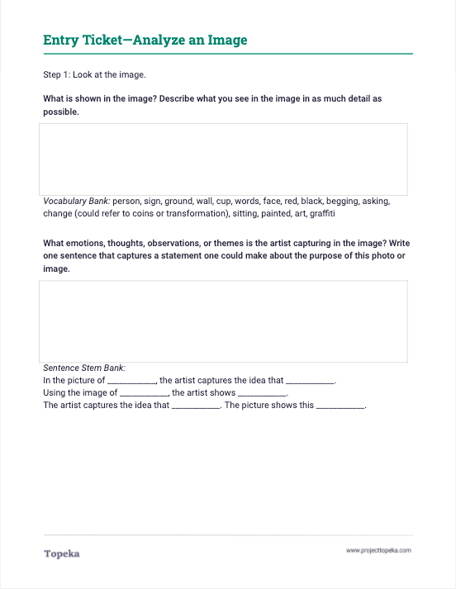
Entry Ticket
Analyze the writing prompt to understand your purpose for reading.
2

Slide 3
In this lesson you will learn…
why we take notes
on texts.
how to highlight and annotate.
how these practices help you read, think, and write.
Notes:
Teachers sets the purpose for the direct instruction by describing learning objectives for class.
Today we’re going to talk about engaging with text by highlighting and annotating as we read. We will learn why we take notes; one method of highlighting and annotating text; and how these practices help you read, think, and write.

Slide 4
How does analyzing a prompt help me take notes?
For certain kinds of academic writing situations, staying focused on the prompt is important and can help you focus your attention on the most important aspects of the reading.
Later the prompt will also help you focus your own writing.
Notes:
How does analyzing a prompt help me take notes?
For certain kinds of academic writing situations, staying focused on the prompt is important and can help you focus your attention on the most important aspects of the reading.
Later the prompt will also help you focus your own writing.

Slide 5
Why do we take notes on text?
Engaging with text or other sources is the first step in the argumentative writing process.
Notes:
Why do we take notes on text? Engaging with text or other sources is the first step in the argumentative writing process.
When you’re making an argument, you’re responding to something, whether it is a text, video, song—even someone else’s argument. For you to make a really good argument, you need to carefully examine what it is that you’re arguing about.

Slide 6
Why do we take notes on text?
Analyzing text helps you gather evidence to support the claim you want to make.
The claim is the idea you are attempting to prove as you make an argument. Your claim should be the focus of your entire essay.
Notes:
Analyzing text helps you gather evidence to support the claim you want to make. The claim is the idea you are attempting to prove as you make an argument. Your claim should be the focus of your entire essay.

Slide 7
One method of taking notes is highlighting and annotating.
Highlighting is marking the text in a way that calls attention to certain words, phrases, or sentences.
Annotating is making notes about why the highlighted text is important.
Notes:
One method of taking notes is highlighting and annotating. What do I mean by this?
Highlighting is marking the text in a way that calls attention to certain words, phrases, or sentences that you think are important has you read.
What are some ways we can highlight text?
When you highlight text, you should also annotate. Annotating is making notes about why the highlighted text is important. You do this so you can easily remember why you highlighted that part of the text in the first place.

Slide 8
Why annotate
the text?
Annotation helps you locate information quickly and determine key elements.
Notes:
Annotation helps you locate information quickly and determine key elements—without having to re-read the text every time.
Another reason to annotate is to consider the underlying issues that are driving the argument. Later, you might develop your initial thoughts and annotations more fully into reasons to support your claims in an argument.

Slide 9
How to Annotate
a Text
Before Reading, you should
review the title of the text;
review any pictures or visuals that accompany the text; and
review an overview of the text, if provided.
These steps will help you understand what you’re about to read.
Notes:
Before Reading, you should take a moment to
read the title of the text
scan any pictures or visuals that accompany the text
read the overview of the text, if provided
These three brief steps will help you understand what you’re about to read.
Teacher asks students to examine the title of the excerpt to get an understanding of what the text is going to be about.

Slide 10
How to Annotate
a Text
During Reading, you should
read the text with your writing prompt in mind; look for evidence that will help you write your argument;
underline or highlight parts of the text that stand out to you as important; and
write notes about the highlights to keep track of what you’re thinking; You can revisit these thoughts later.
Notes:
Teacher displays the “during reading” slide and reviews the steps students should take during the reading of the text:
There are things you can do while you’re reading to help you pay close attention to details and to remember later what you read:
Read the text with your writing prompt in mind. Look for evidence that will help you write your argument.
Underline or highlight parts of the text that stand out to you as important.
Write notes about the highlights to keep track of what you’re thinking. You can revisit these thoughts later.

Slide 11
Read Closely to Discover Issues
During highlighting and annotating, look for issues that drive the debate.
An issue is an underlying idea that can be debated. It has at least two sides.
Multiple arguments—even opposing arguments—can be built based on a single issue.
Cost is an example of an issue people debate when they discuss school uniforms.
Notes:
During highlighting annotating, readers should look for issues. An issue is an underlying idea that can be debated. It has at least two sides. Multiple arguments can be built from a single issue. Even opposing arguments can be built based on a single issue. An example of an issue people debate when they discuss school uniforms is cost.

Slide 12
How to Annotate
a Text
After Reading, you should
reread your annotations; and
use your annotations and notes when responding to the prompt.
Notes:
Teacher displays the “after reading” slide and explains
When you’re finished reading, you should review what you’ve highlighted and the notes you took.
Then use this information when you’re preparing to respond to the writing prompt.

Slide 13
How does note-taking help you write?
The evidence you find when reading a text can help support the argument you make in your writing.
Notes:
Teacher continues.
How does note-taking while reading help you write? The evidence you find when reading can help support the argument you make in your writing.
For example, during the entrance activity, we looked at what the possible responses to the prompt might be. With those responses in mind, you can review your notes on the reading to help decide what position you can support—or argue against—with more detail from the text.
Teacher reminds students that they are looking for evidence to determine whether uniforms are a good or bad idea:
In the entrance activity we examined the writing prompt and discovered our purpose for reading. Can someone remind us of what that purpose was and what the possible stances we can take might be?

Slide 14
Many schools encourage parents to support a school-wide uniform policy by claiming that uniforms reduce clothing costs and make providing clothing easier for parents. In actuality, the cost of school uniforms has been proven to be greater than the cost of regular clothes. Within a uniform policy, schools specify certain items of clothing and accessories that must be worn by all students. Often, these items are only available for purchase from particular stores or manufacturers. This lack of purchasing options makes it harder for parents to find competitive pricing and limits parents’ choice of how much to spend on their children's clothing. Other times, uniforms are available only from online retailers, which presents extra challenges for parents without credit cards or for students living in temporary situations.
Whole Group Model
Notes:
Teacher reads aloud excerpt: See slide
Teachers thinks aloud:
This paragraph explains a negative aspect of uniforms, which has to do with cost and accessibility, as we predicted from the title.
Now I am going to reread the text to underline a detail that supports why uniforms are a bad idea. “Schools specify the clothing and accessories that must be worn by all students’”would be important because it explains that parents have to buy what the school tells them.
Teacher thinks aloud:
Now that we have underlined a detail that we think is important, we need to take notes to remind us of our thinking and reason for underlining. Looking at what we underlined, I am going to write, “parents have to buy what they’re told, no matter the cost.” That will remind me of why I highlighted this detail.
Teacher prompts class to find another key detail and explain their reason for highlighting the detail.
After the class completes highlighting, teacher should note that the issue at hand:
The major issue this piece talks about is cost, but there are other issues in the debate over school uniforms that we will debate later.

Slide 15
How to Annotate a Text
Do:
Don’t:
Read with a purpose, such as answering a question or responding to a prompt.
Highlight a few words or phrases for each detail.
Write your annotation as a quick note (fewer than two sentences).
Write only your reactions to the text.
Highlight the entire text.
Write a lengthy full response to a question.
Notes:
In a moment we will read another text describing some more pros and cons of school uniform policies. As you work together to read the text closely, there are some key rules to keep in mind:
Do read with a purpose; know what you’re looking for. Don’t just read and react.
Do highlight just the important details. Don’t highlight the whole text. When you highlight too much, nothing stands out.
Do write your annotations as quick notes—just enough that you’ll understand your highlight. Don’t write lengthy paragraphs. Try to note the issue that might have prompted you to highlight the text.

Slide 16
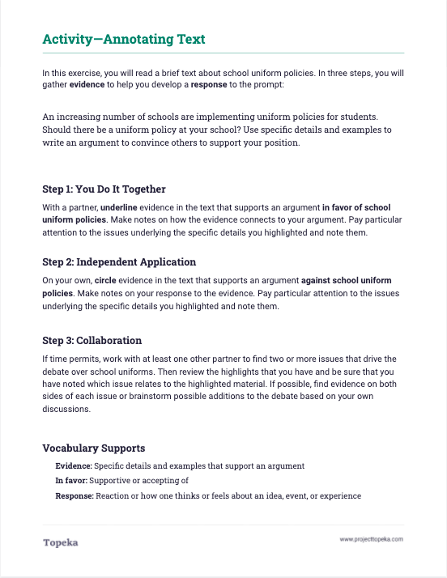
You try it.
Read the text about School Uniforms with a position in mind.
You Do It Together: In pairs, highlight or underline evidence that supports the argument.
Annotate your highlight, making a brief note as to how the evidence connects to your claim.
Independent Application: Independently, highlight or circle evidence that supports the opposite position.
Annotate your highlights, making brief notes on your response to the evidence.
14
Notes:
Teacher distributes the activity: “Annotating Text” and leads students (or prompts students to perform) an initial read of the brief text “School Uniforms.”
After class read-aloud, teacher instructs students to complete the activity. See lesson plan for additional details.

