Slide 1
Evidence Checklist Activity
Additional Tools

Slide 2
In this lesson you will learn…
what makes strong evidence.
how to evaluate evidence.
how these practices help you read, think, and improve writing.
Notes:
Teachers sets the purpose for the direct instruction by describing learning objectives for class.
Today we’re going to watch a short video to help review what makes strong evidence; how to evaluate evidence; and how these practices help you read, write, and think. Then we’ll work with others to evaluate the evidence selections you have already made. Later you’ll use that evaluation when you revise your essay.

Slide 3
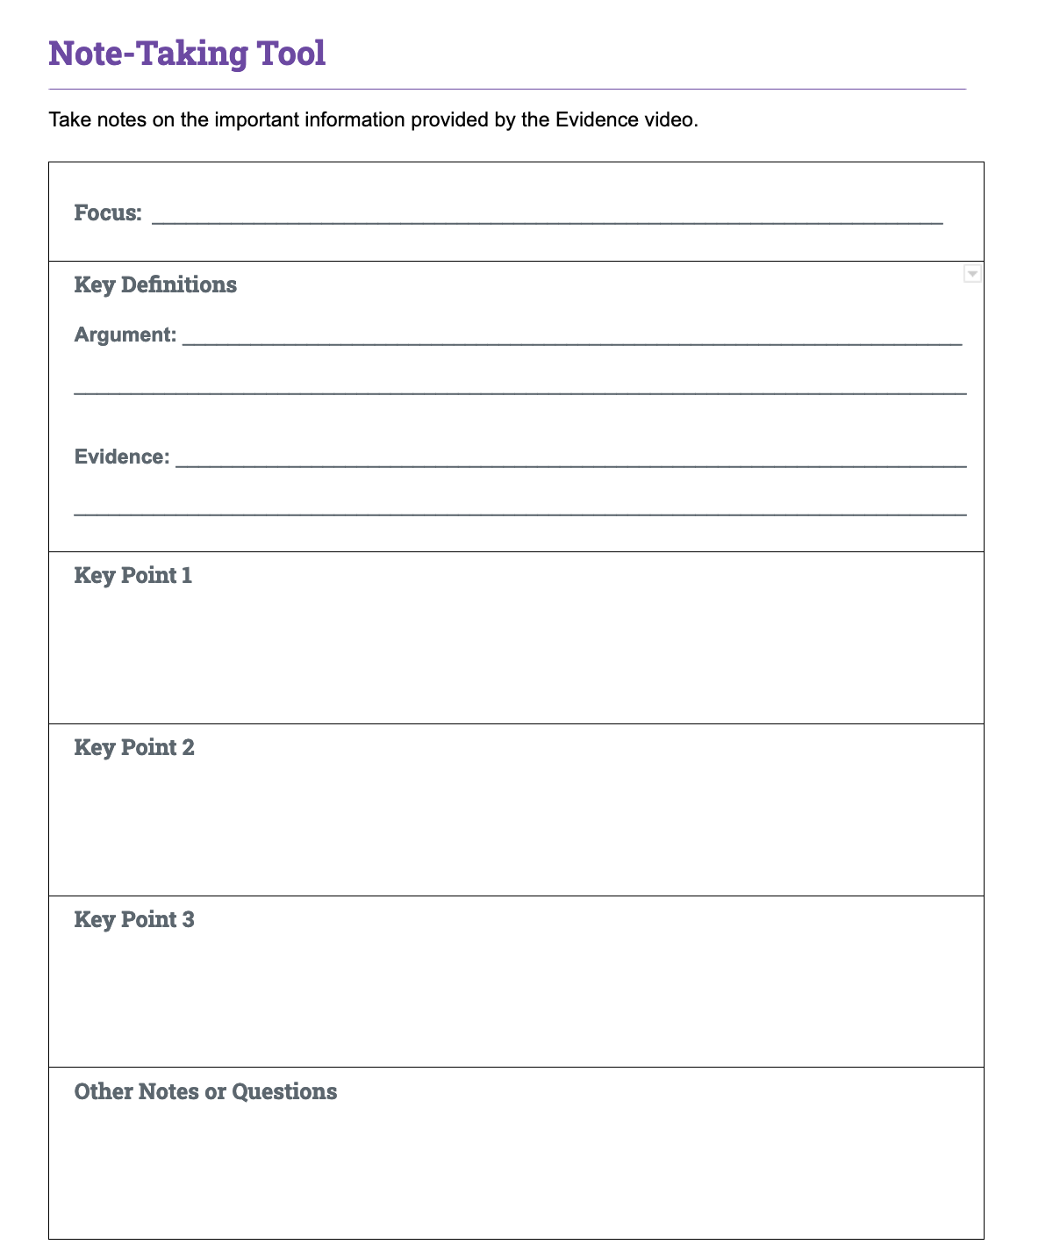
Evidence
Video and Tools
7
Notes:
Teacher has students complete the note-taking activity while viewing the evidence video.
Use the note-taking handout to organize your notes on the video.
Upon completion, teacher invites students to Pair and Share with a classmate to discuss their answers.
Discuss your understanding of what makes strong evidence with your neighbor.

Slide 4
Reasons and reasoning help build arguments.
Reasons
Reasoning
Reasons explain why you believe your claim
Reasons provide an organizational structure
Links your evidence to your reasons and back to your claim
Explains how you interpret evidence
Demonstrates your knowledge of the topic or text
Notes:
Teacher leads whole group debrief of the video, inviting students to share what they wrote for the focus and key points. Teacher invites students to ask questions.
Teacher explains reasons and reasoning as they relate to evidence.
The video reviewed the criteria we should use to select evidence. Since selecting evidence is closely related to reasons and reasoning, let’s review those terms as well.
Reasons explain why you believe your claim. For example, imagine I were making this claim: “Schools should set aside time during the school day for students to read independently.”
My reasons might be that independent reading makes students into better readers and independent reading is an enjoyable activity for students.
Reasoning is an explanation of how your reason (and the evidence you’ll add) connect to your claim.
Reasons and reasoning are very important in writing arguments—these are the building blocks of the support you'll give your claim. Without the reasoning to organize and support your use of evidence, the evidence and the argument aren't as strong.

Slide 5
What is the difference between reasons and reasoning?
Reasons
Reasoning
What you think
The main points of your argument
Why you think this reason is proven by evidence.
Explains your thinking about evidence and its link to your reasons and claim
Notes:
Teacher continues to contrast reasons and reasoning.
Reasons are what you think
Reasoning is an explanation of how your evidence is relevant to your claim.

Slide 6
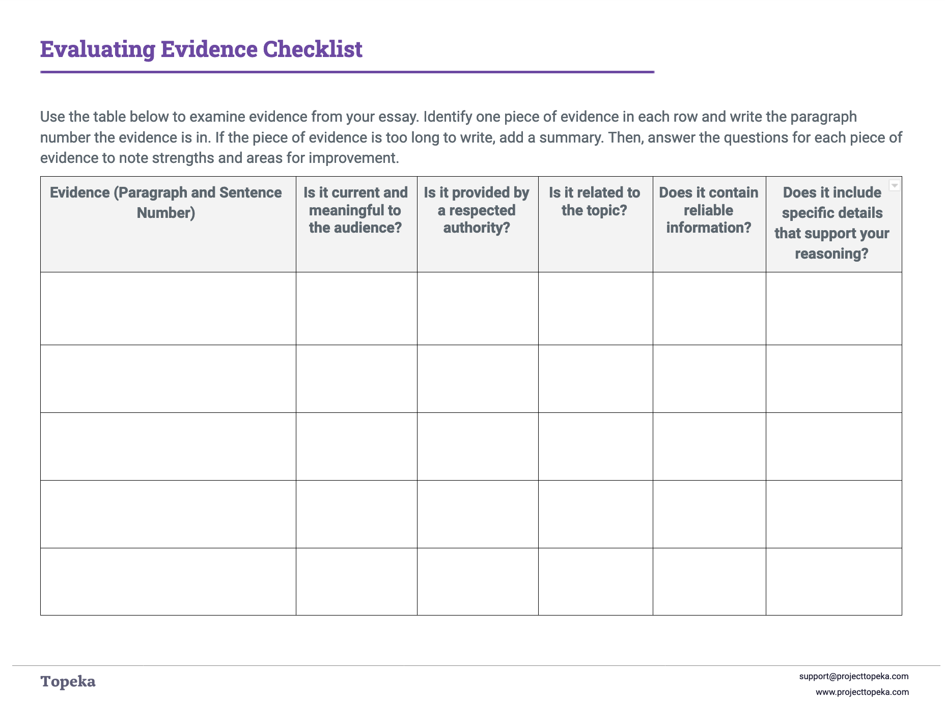
Evidence Checklist
With a partner, review the evidence each of you has selected and provide feedback.
Notes:
Explain that students will work together to evaluate each other’s evidence selection.
When writing arguments, we use evidence to show that our reasons are valid—to prove that our argument should be accepted. Together, you will work to evaluate the evidence you have selected, and give feedback to help each other strengthen your evidence selection.
Teacher explains that students will work alone to complete revisions.
When it’s time to revise your essay, consider the feedback your partner provided, and review your evidence selections critically to determine if the evidence is effective and sufficient. Where changes are needed, also consider the impact of reasons and reasoning in positioning the evidence.

